Slide 1
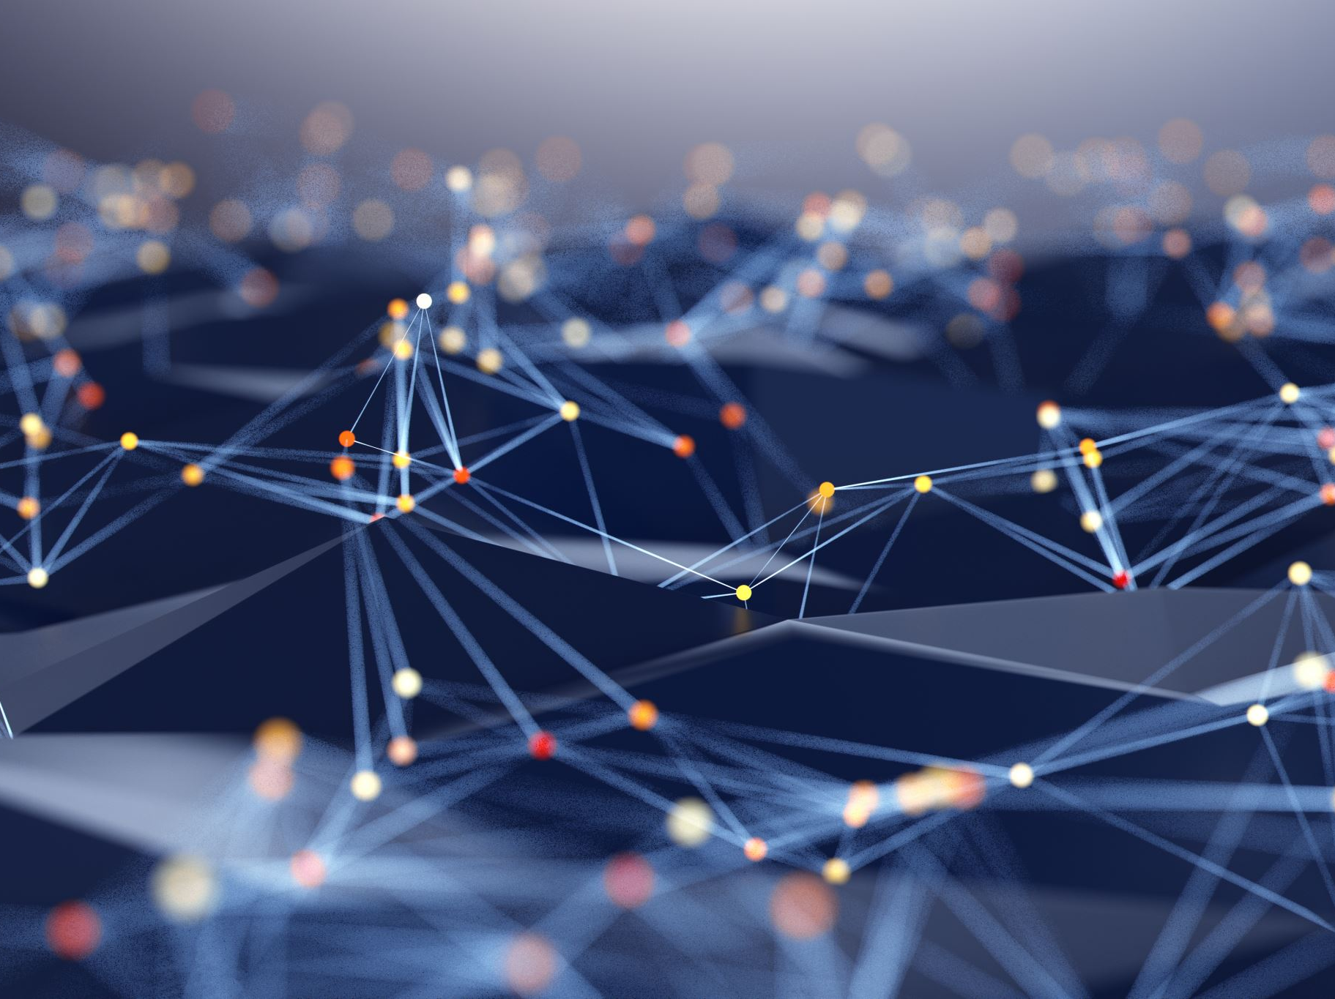

Slide 2
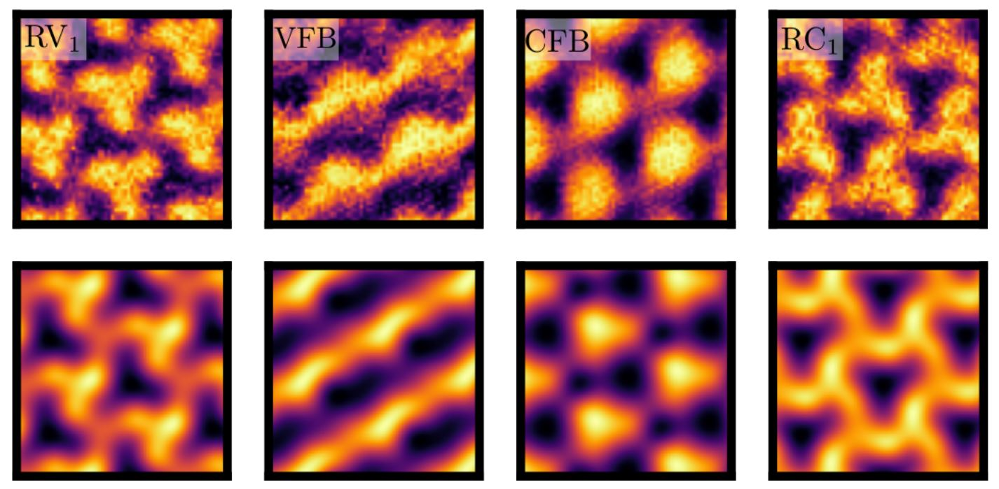
Interpretable ML
https://arxiv.org/pdf/2302.12274.pdf
Notes:
„Interpretable ML“ bedeutung unklar

Slide 3
Our Approach
Fisher Information
Method of describing a neural network from the perspective of information geometry
Can be used to optimize Gradient Descent
Applications in physics
Project overview:
Derived a new mathematical relationship between the trace of the Fisher Information and the Neural Tangent Kernel
Implemented and used this relationship for an example problem
Computed curvature for another simple machine learning example
Notes:
Mehr Zugang zu warum Fisher information interessant is. Derive relationship between differential geometry and training dynamics (fisher und curvature sind zwei unterpunkte von differential geometry). Swap Project overview und Fisher. So wenig text wie möglich

Slide 4
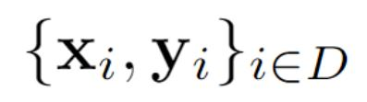
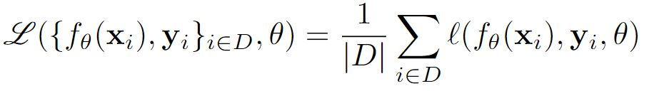
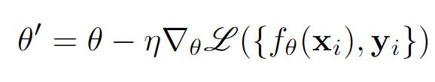
Supervised learning framework
Network
Dataset
Loss Function
Gradient Descent
2
Notes:
Erklären anhand von beispiel. Anfangen mit datenset. Learning rate kurz erwähnen. Ableiten „with respect to“. Ell auch zu beispiel connecten (ist loss von EINEM bild). Deutlich emphasizen was Loss function bedeutet

Slide 5
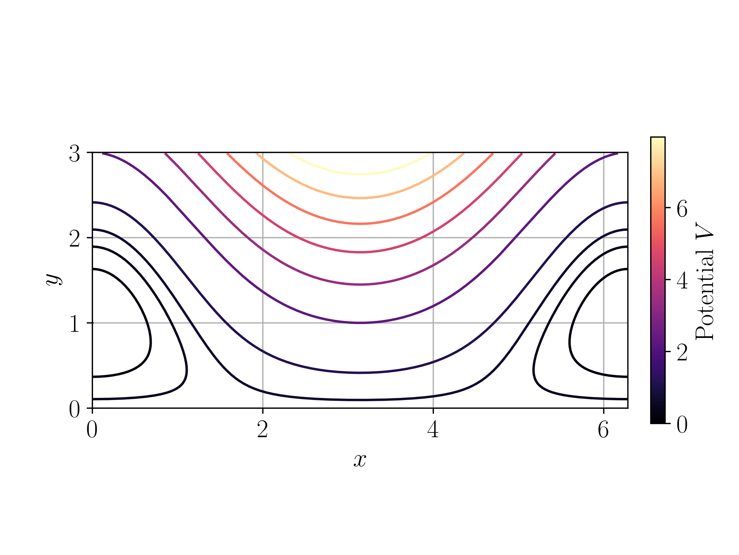
Gradient Descent
1
Notes:
Bisschen analogon ziehen zu surface von grade eben

Slide 6
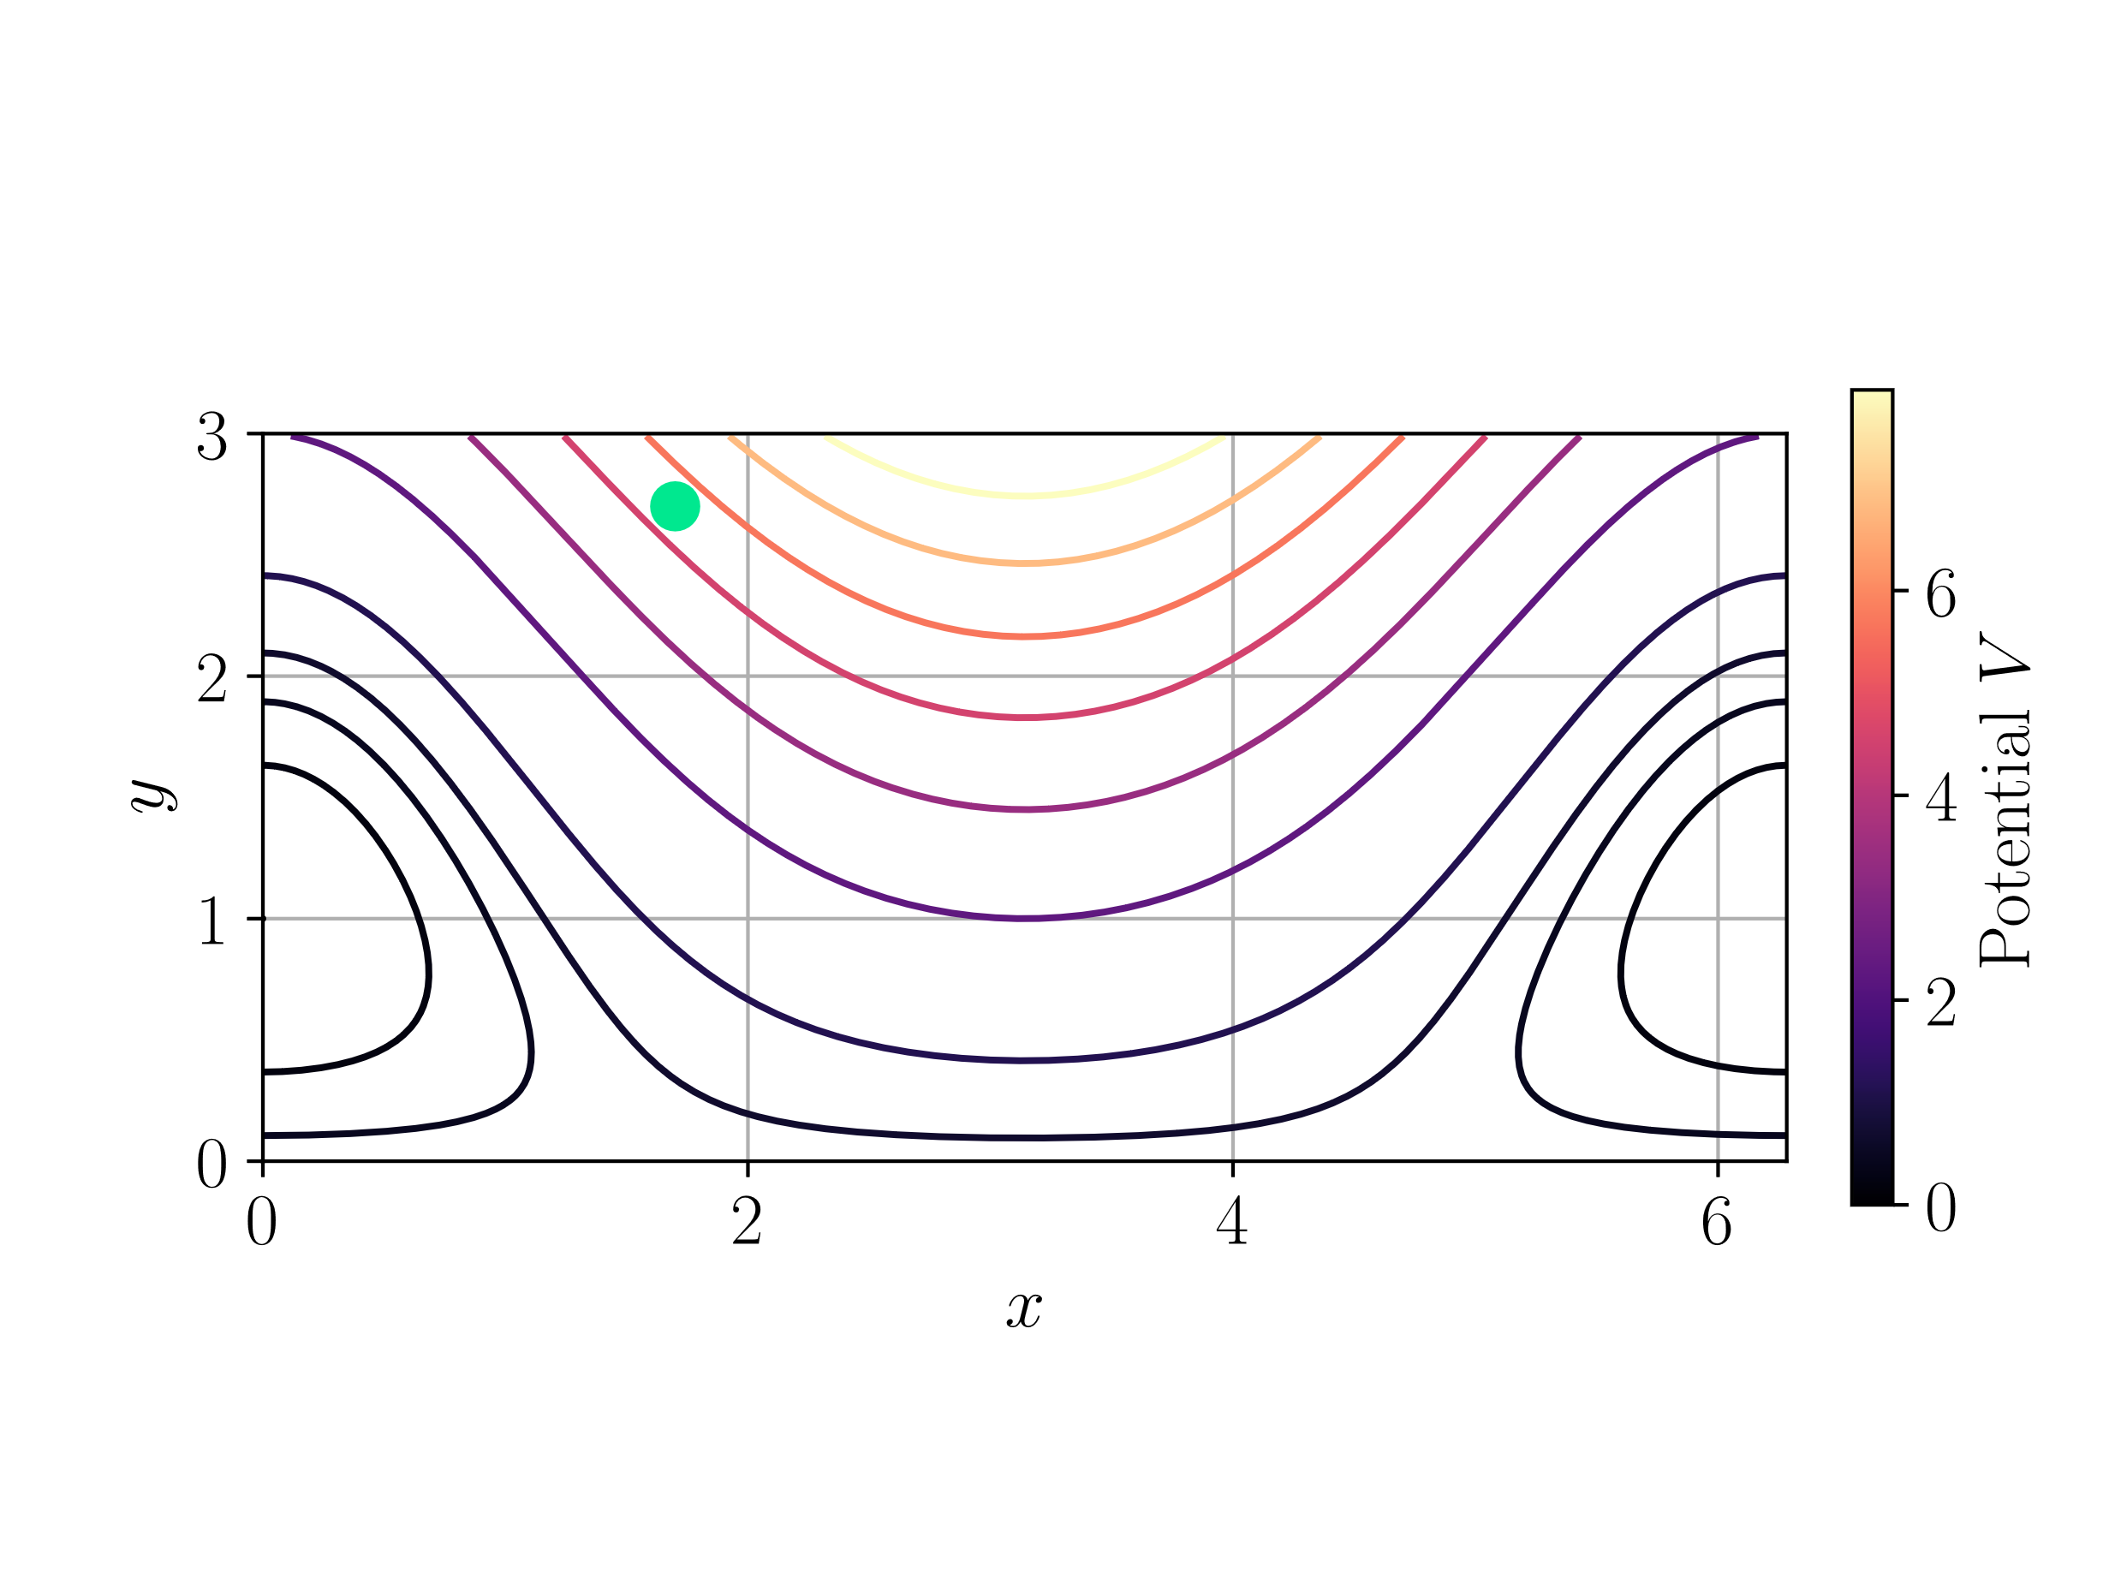
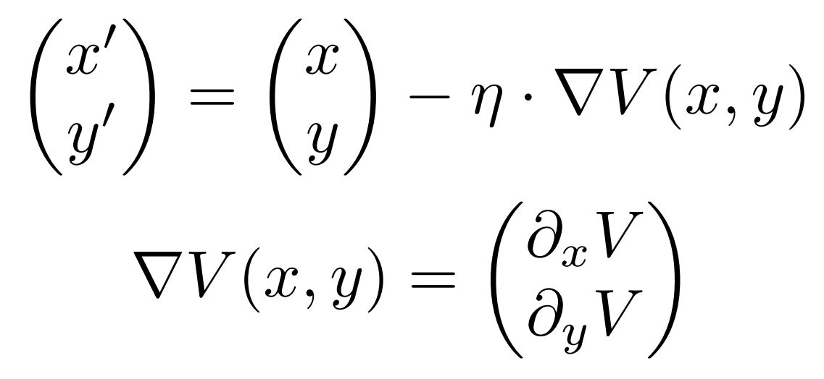
Gradient Descent
1

Slide 7
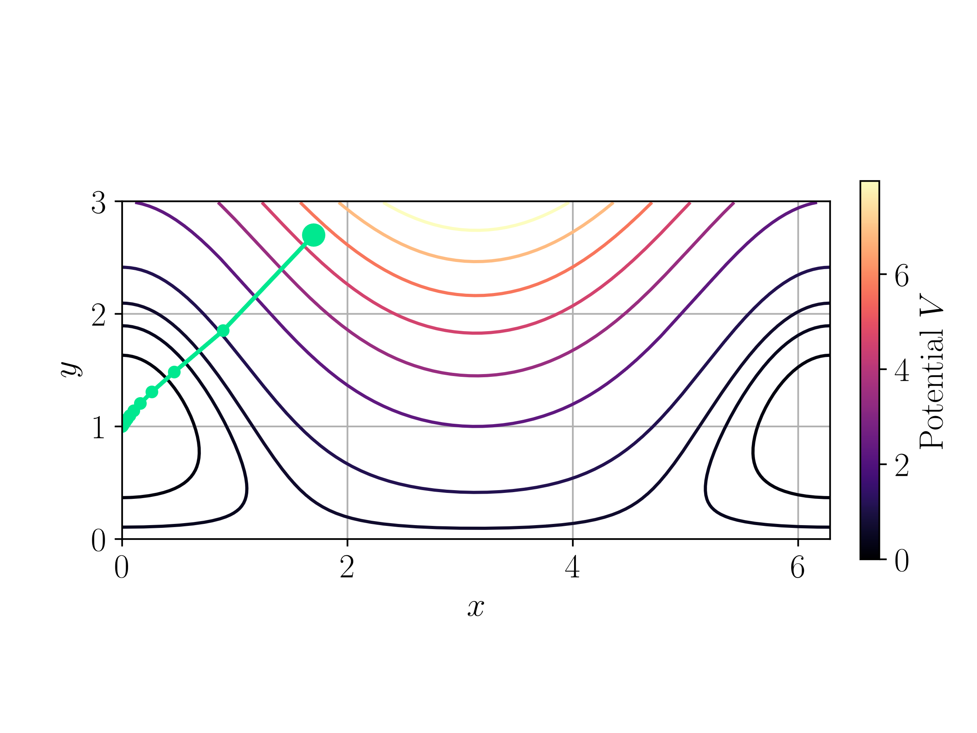
Gradient Descent
1

Slide 8
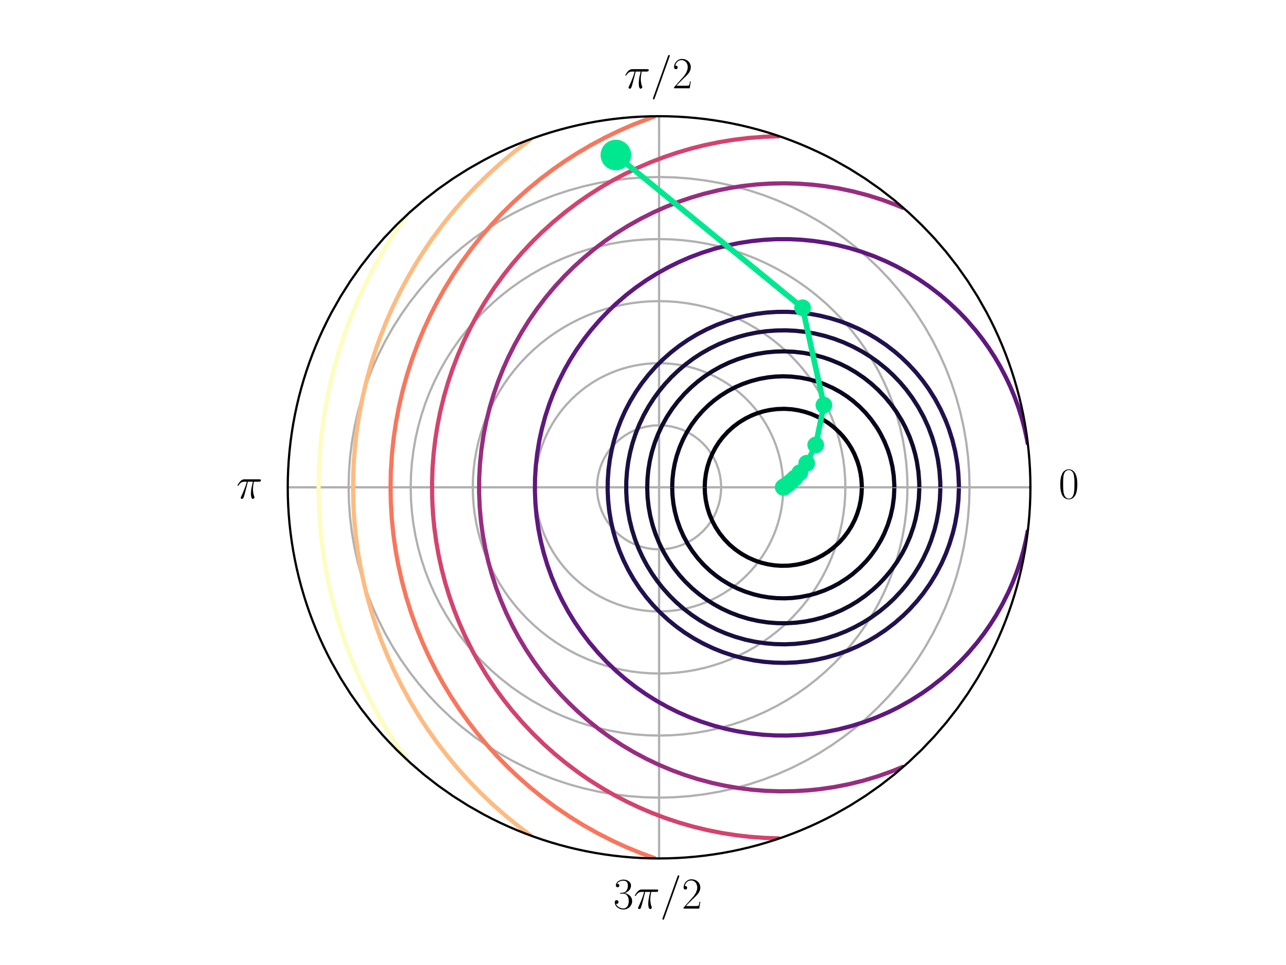

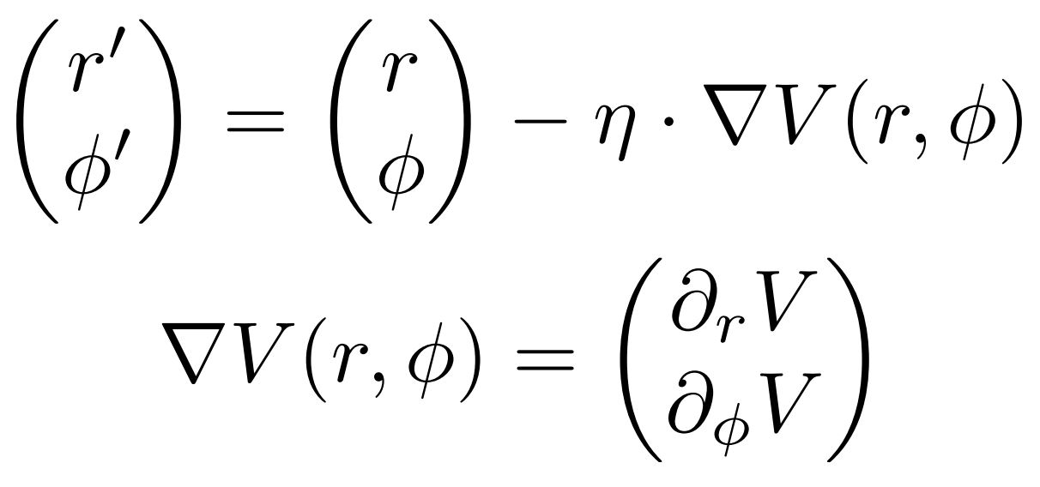
Gradient Descent
1

Slide 9
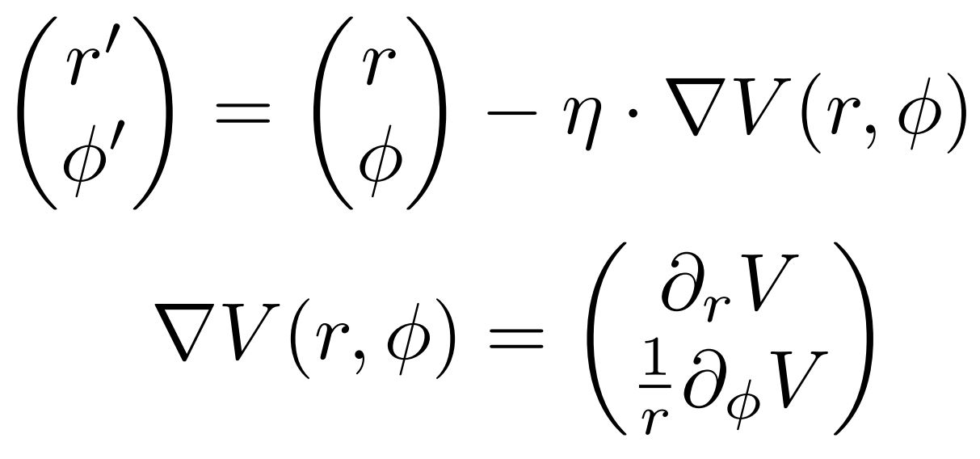
Gradient Descent
1

Slide 10
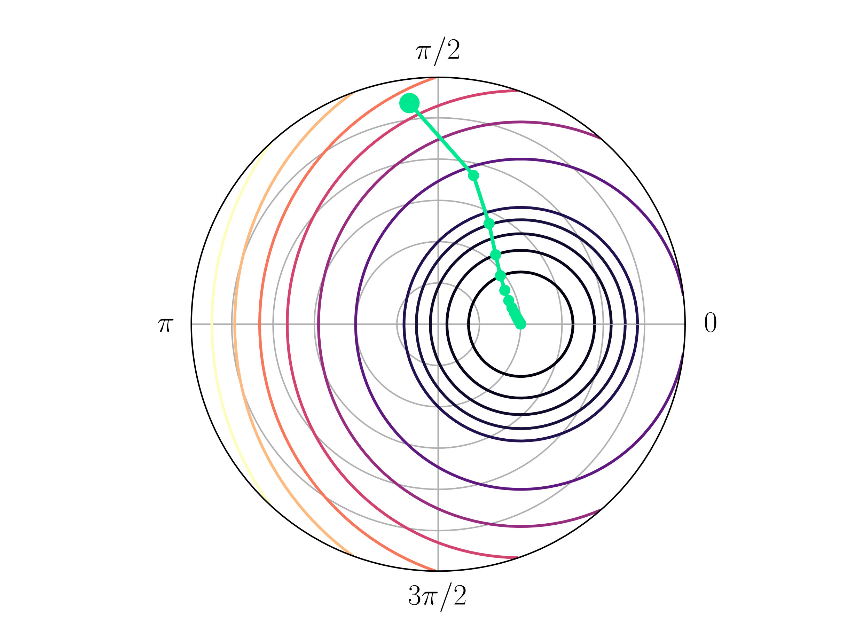
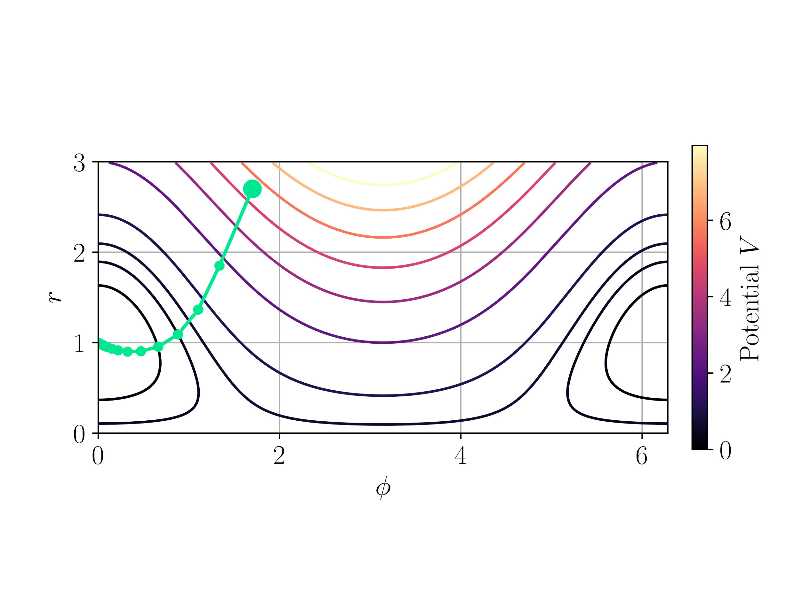
Gradient Descent
1

Slide 11
Supervised learning Framework
Network
Dataset
Loss Function
Gradient Descent
2

Slide 12
Supervised learning Framework
Network
Dataset
Loss Function
Natural Gradient Descent
2
Notes:
Mehr visuellen Fokus auf Fisher Information. Erst größe beschreiben und GANZ AM ENDE erst sagen dass das die Fisher information I ist.

Slide 13
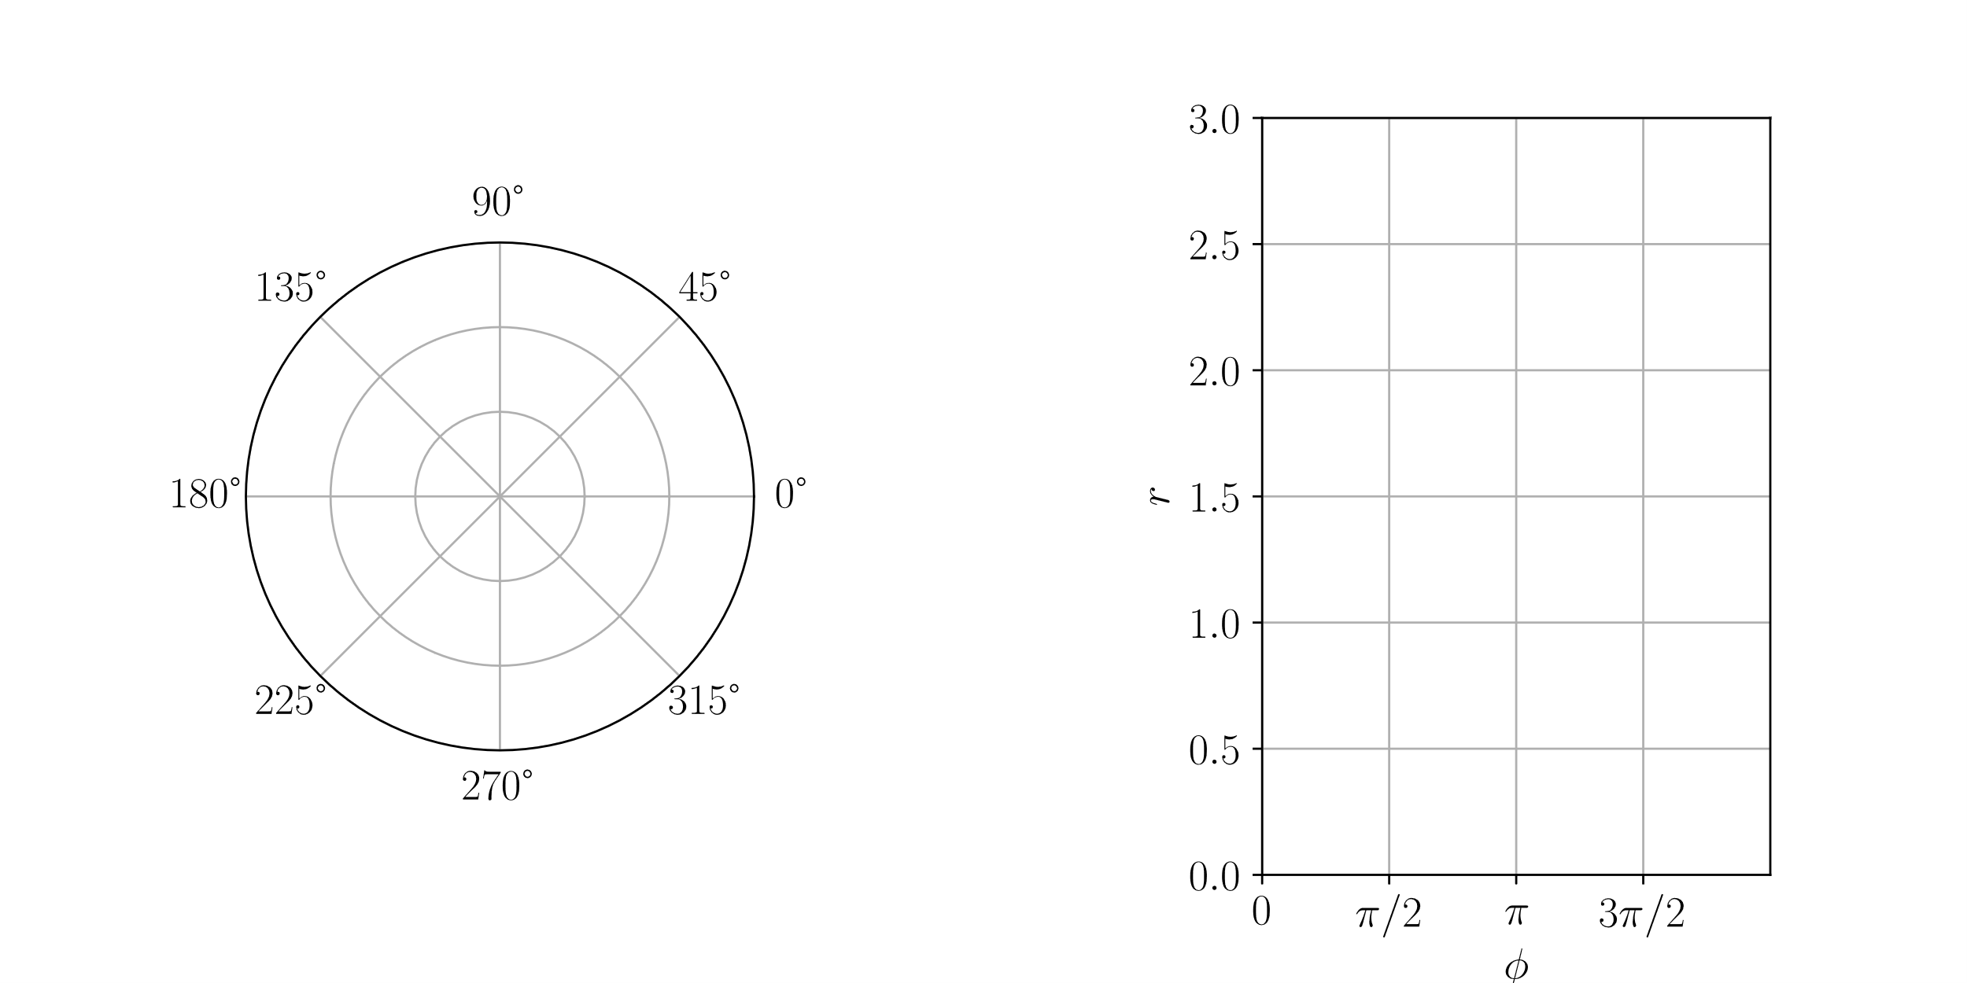
Manifolds and Metrics
Definition:
A manifold is a topological space that is locally isomorphic to euclidean space.
3

Slide 14
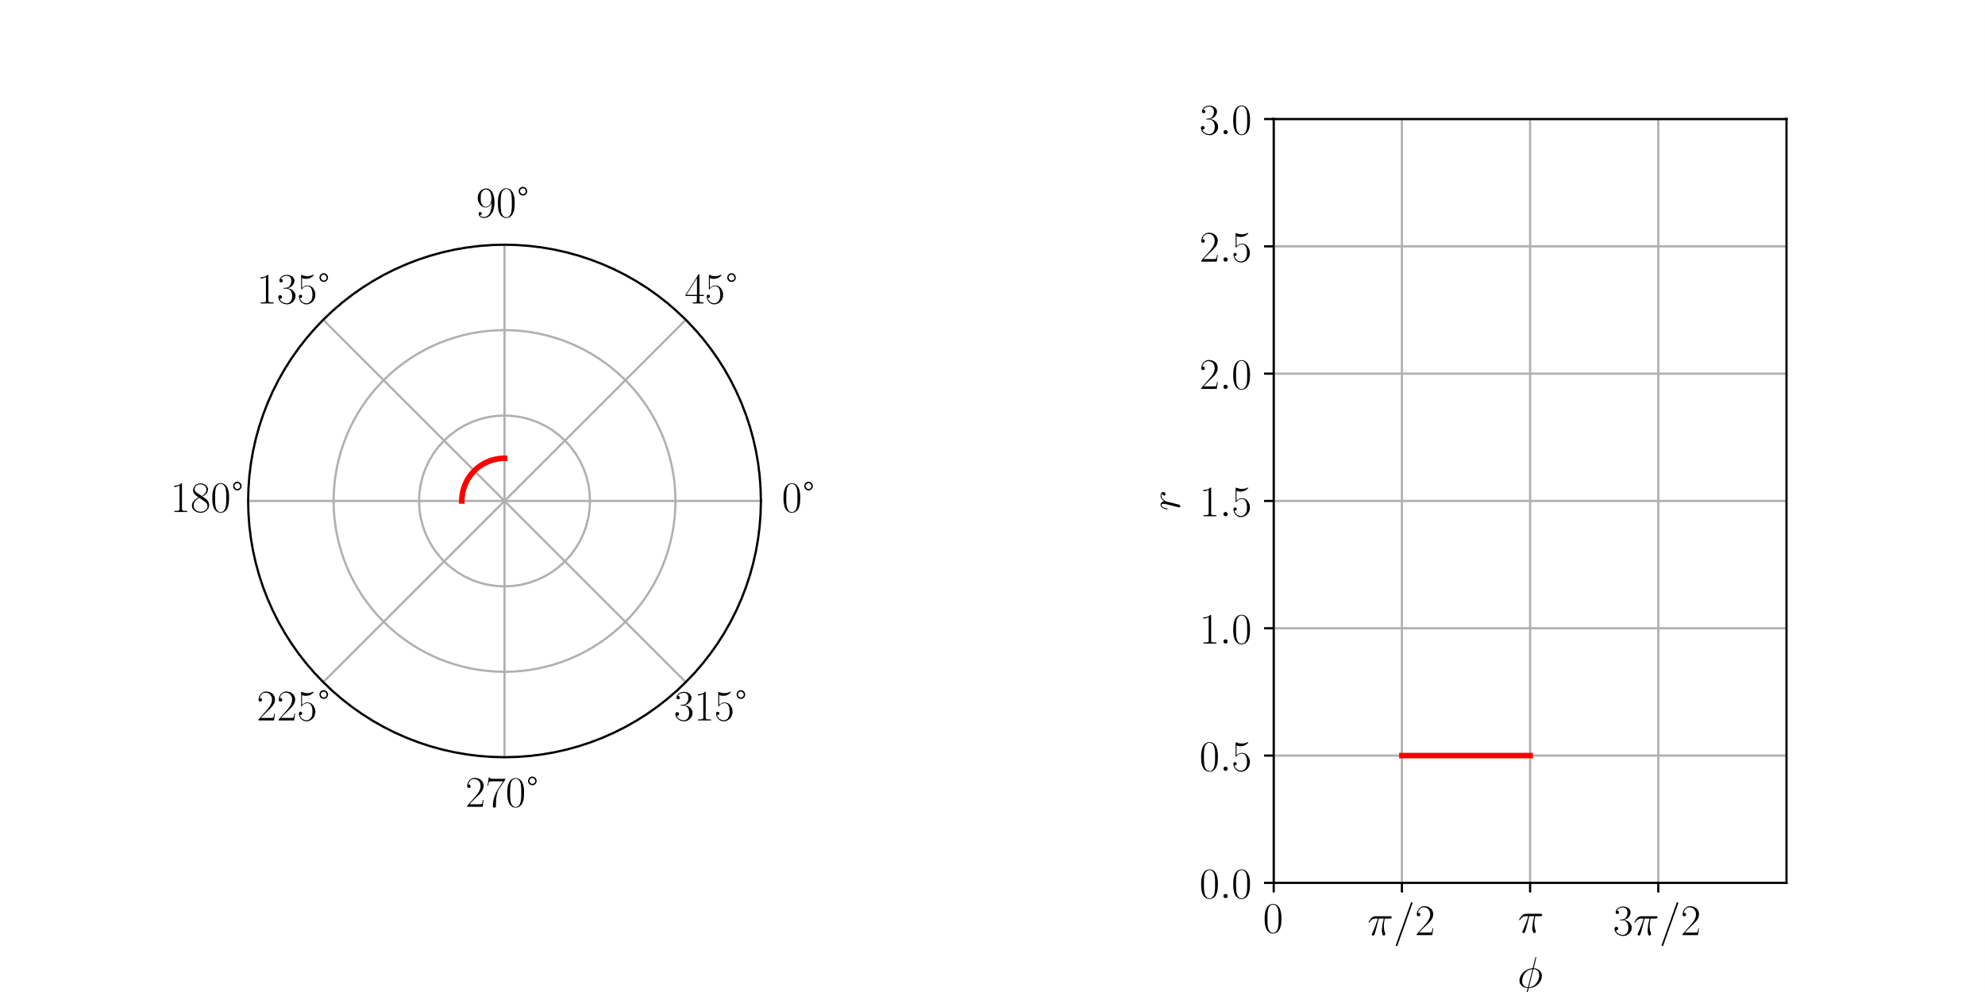
Manifolds and Metrics
Definition:
A manifold is a topological space that is locally isomorphic to euclidean space.
3

Slide 15
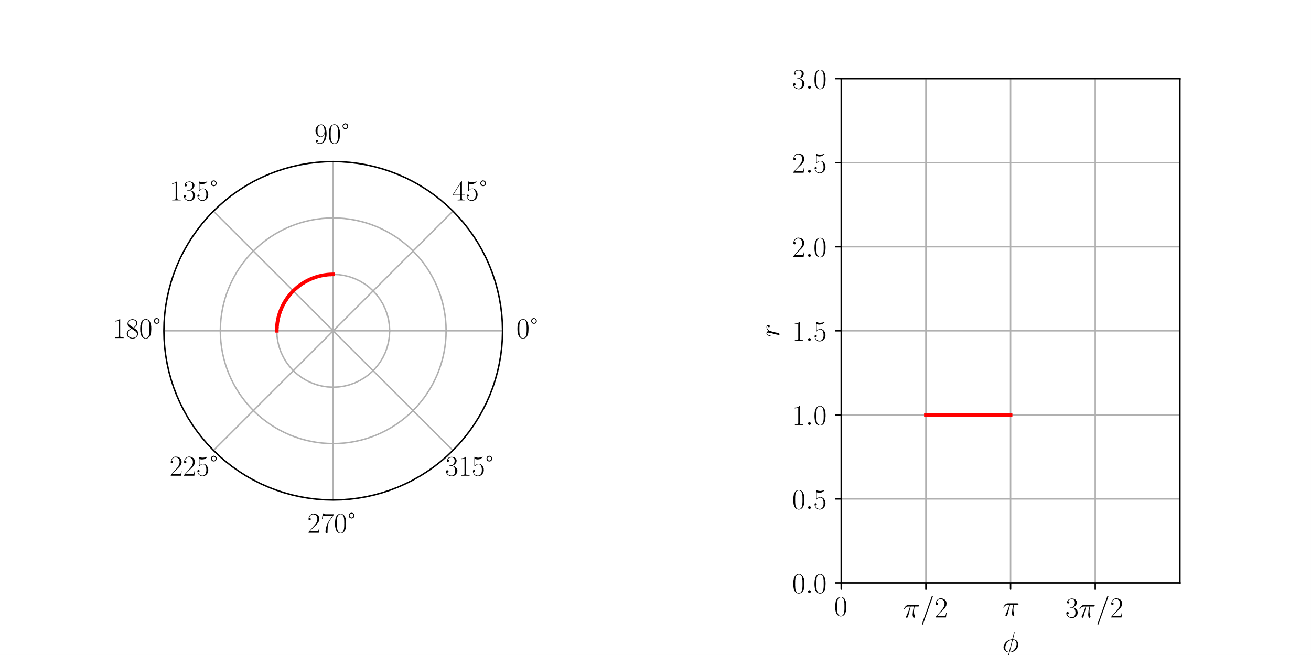
Manifolds and Metrics
Definition:
A manifold is a topological space that is locally isomorphic to euclidean space.
3

Slide 16
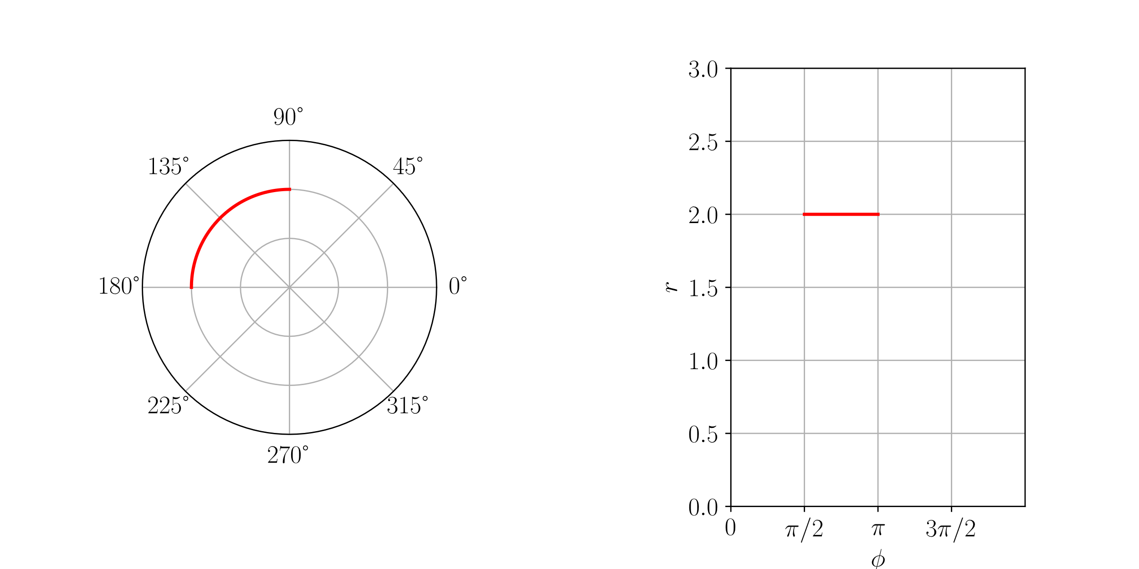
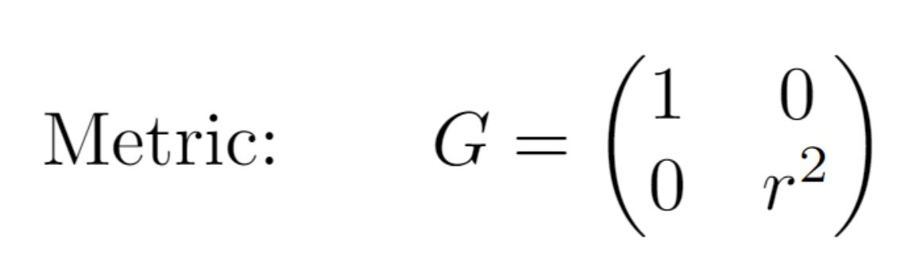
Manifolds and Metrics
Definition:
A manifold is a topological space that is locally isomorphic to euclidean space.
3
Notes:
Wort Metric streichen, visuell metrik bedeutung hervorheben, „Riemann“

Slide 17
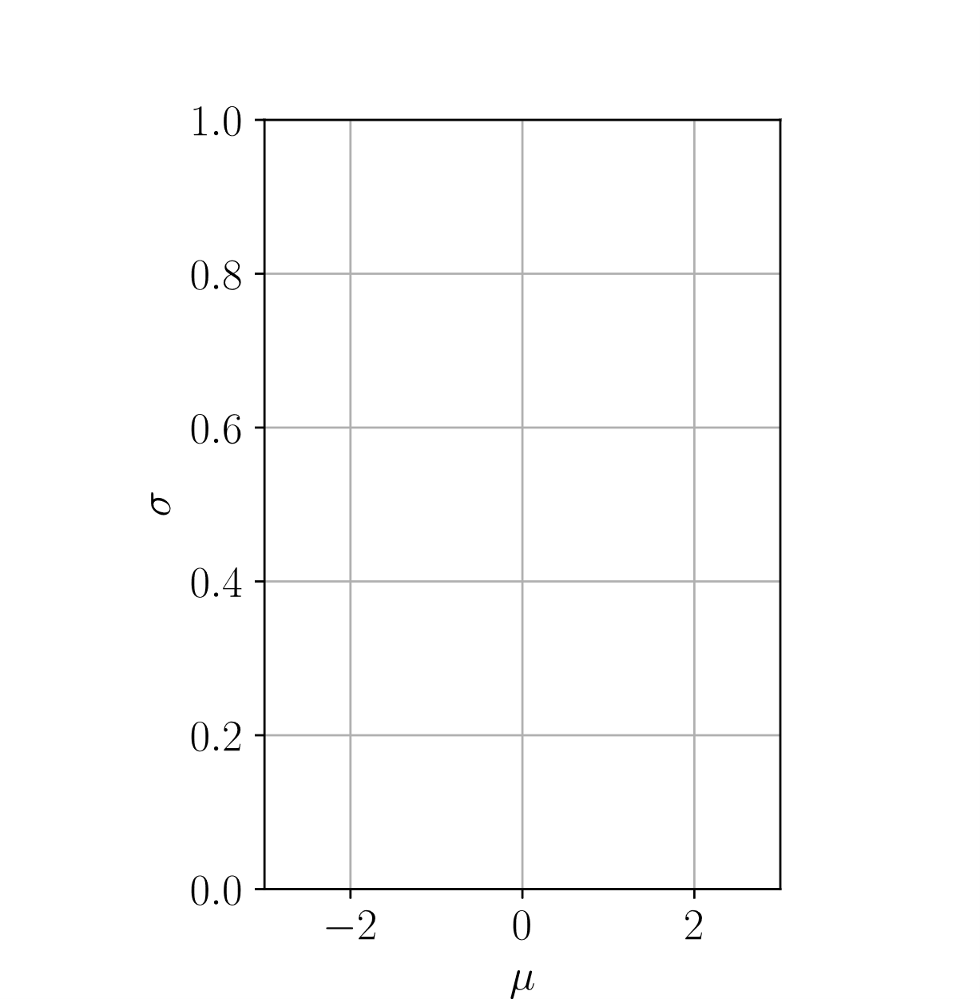
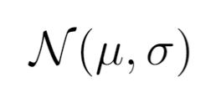
Statistical manifolds
4
Notes:
Hier klarer machen was passiert

Slide 18
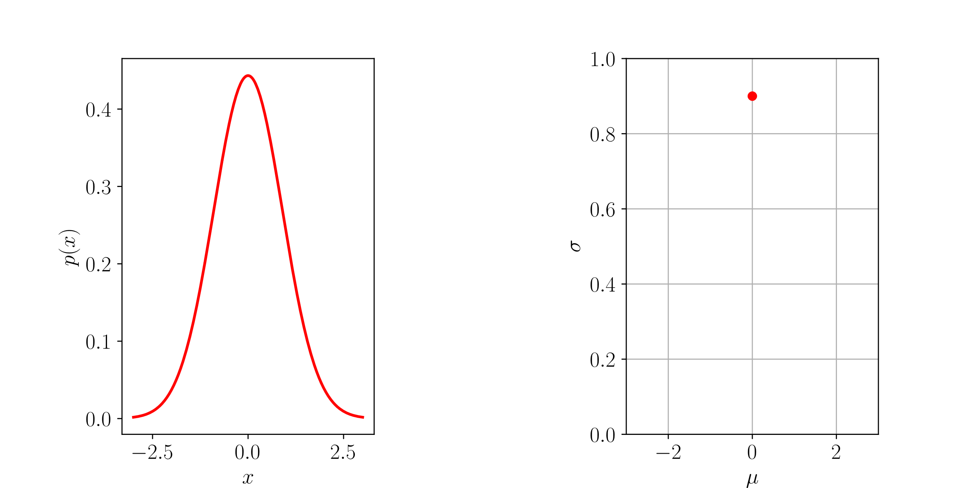
Statistical manifolds
4

Slide 19
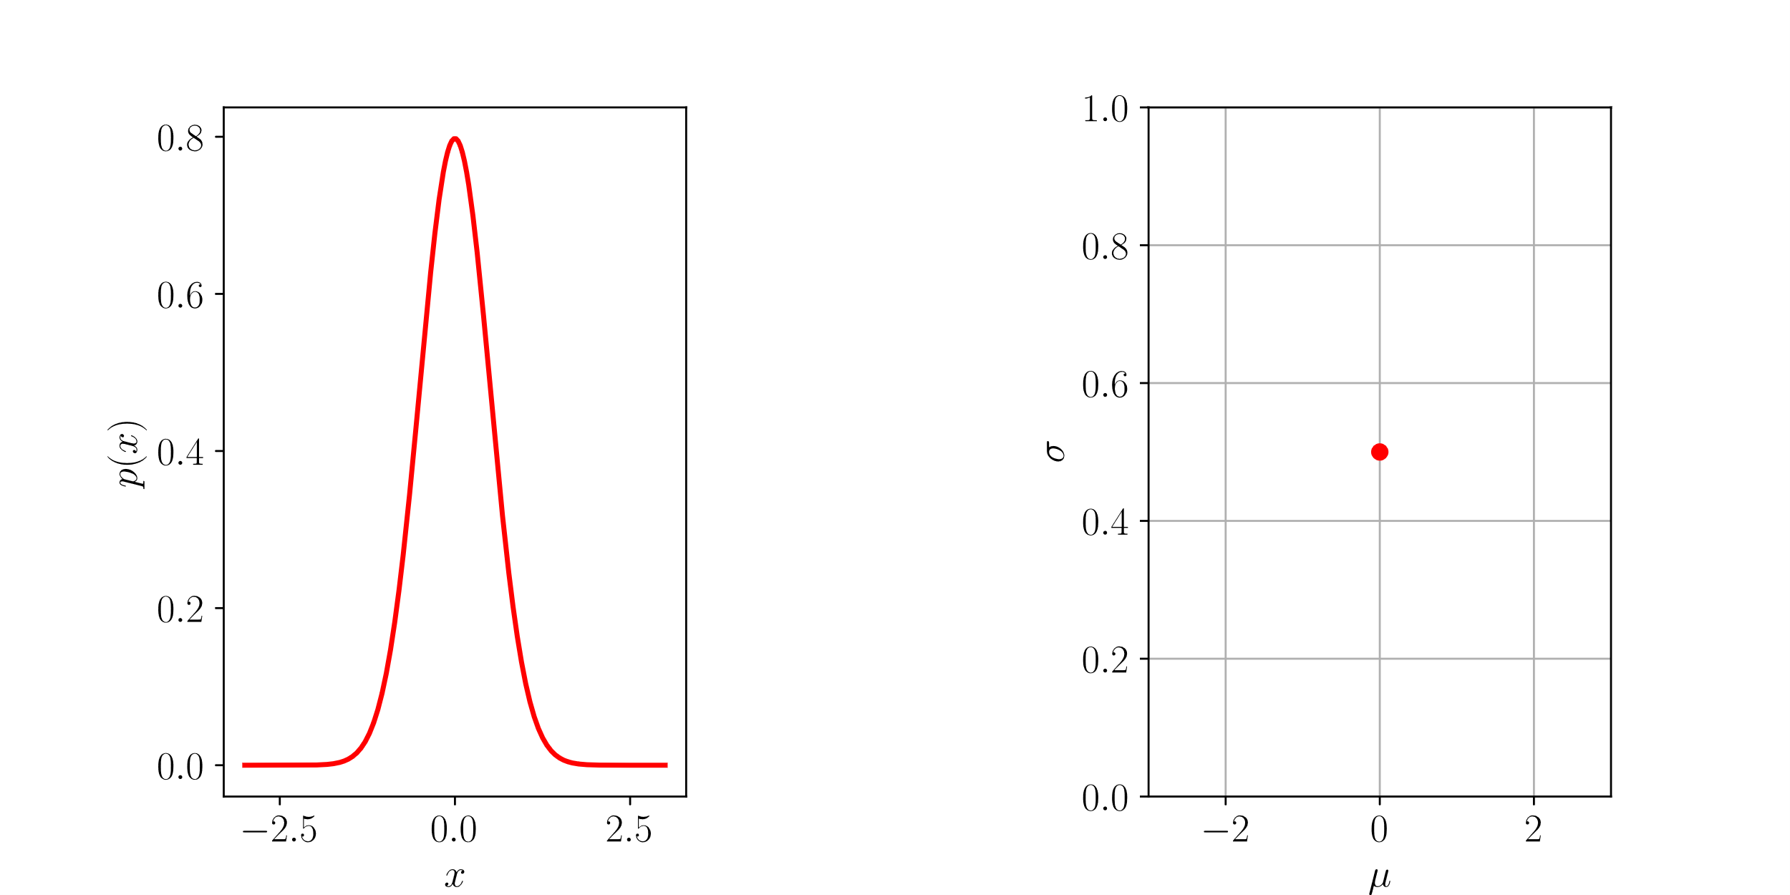
Statistical manifolds
4

Slide 20
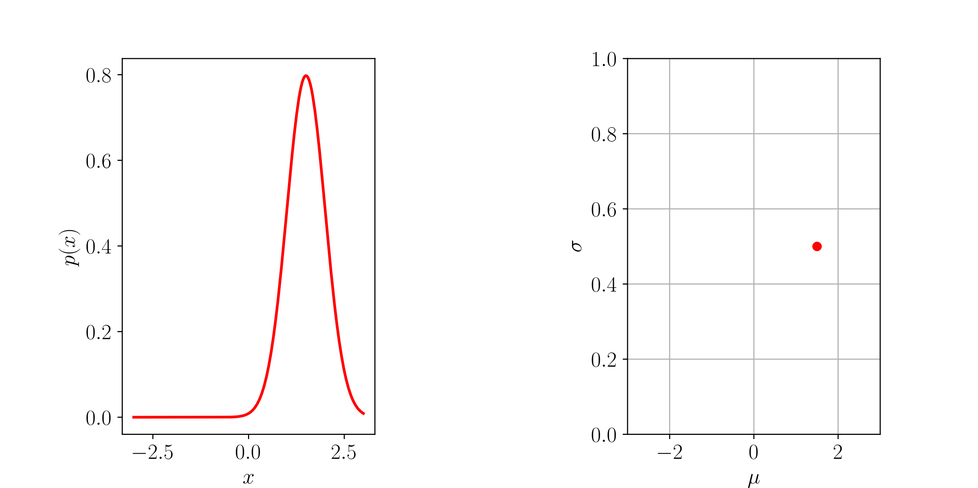
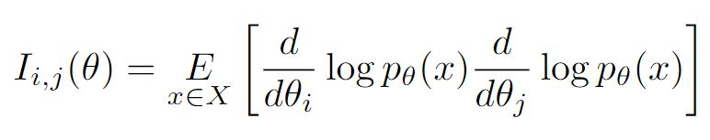
Statistical manifolds
4
Notes:
Differential aufrecht, Erwähnen was theta bedeutet, „Distanz“ mit zwei distributions verdeutlichen

Slide 21
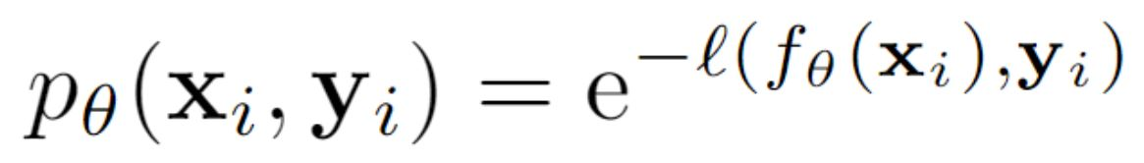
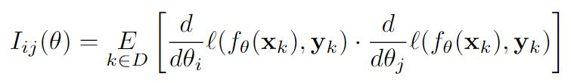
Statistical manifolds
Fisher information of a Neural Network:
5
Notes:
We can DEFINE p in our case like this or leave p out completely. Motivate relationship instead of approximation. This definition CONNECTS probability with NN. Make connection between network parameters and distribution parameters clear so that people know that the parameters are the new coordinates.
Show parameter dimension visually -> explain full equation (like NTK)

Slide 22
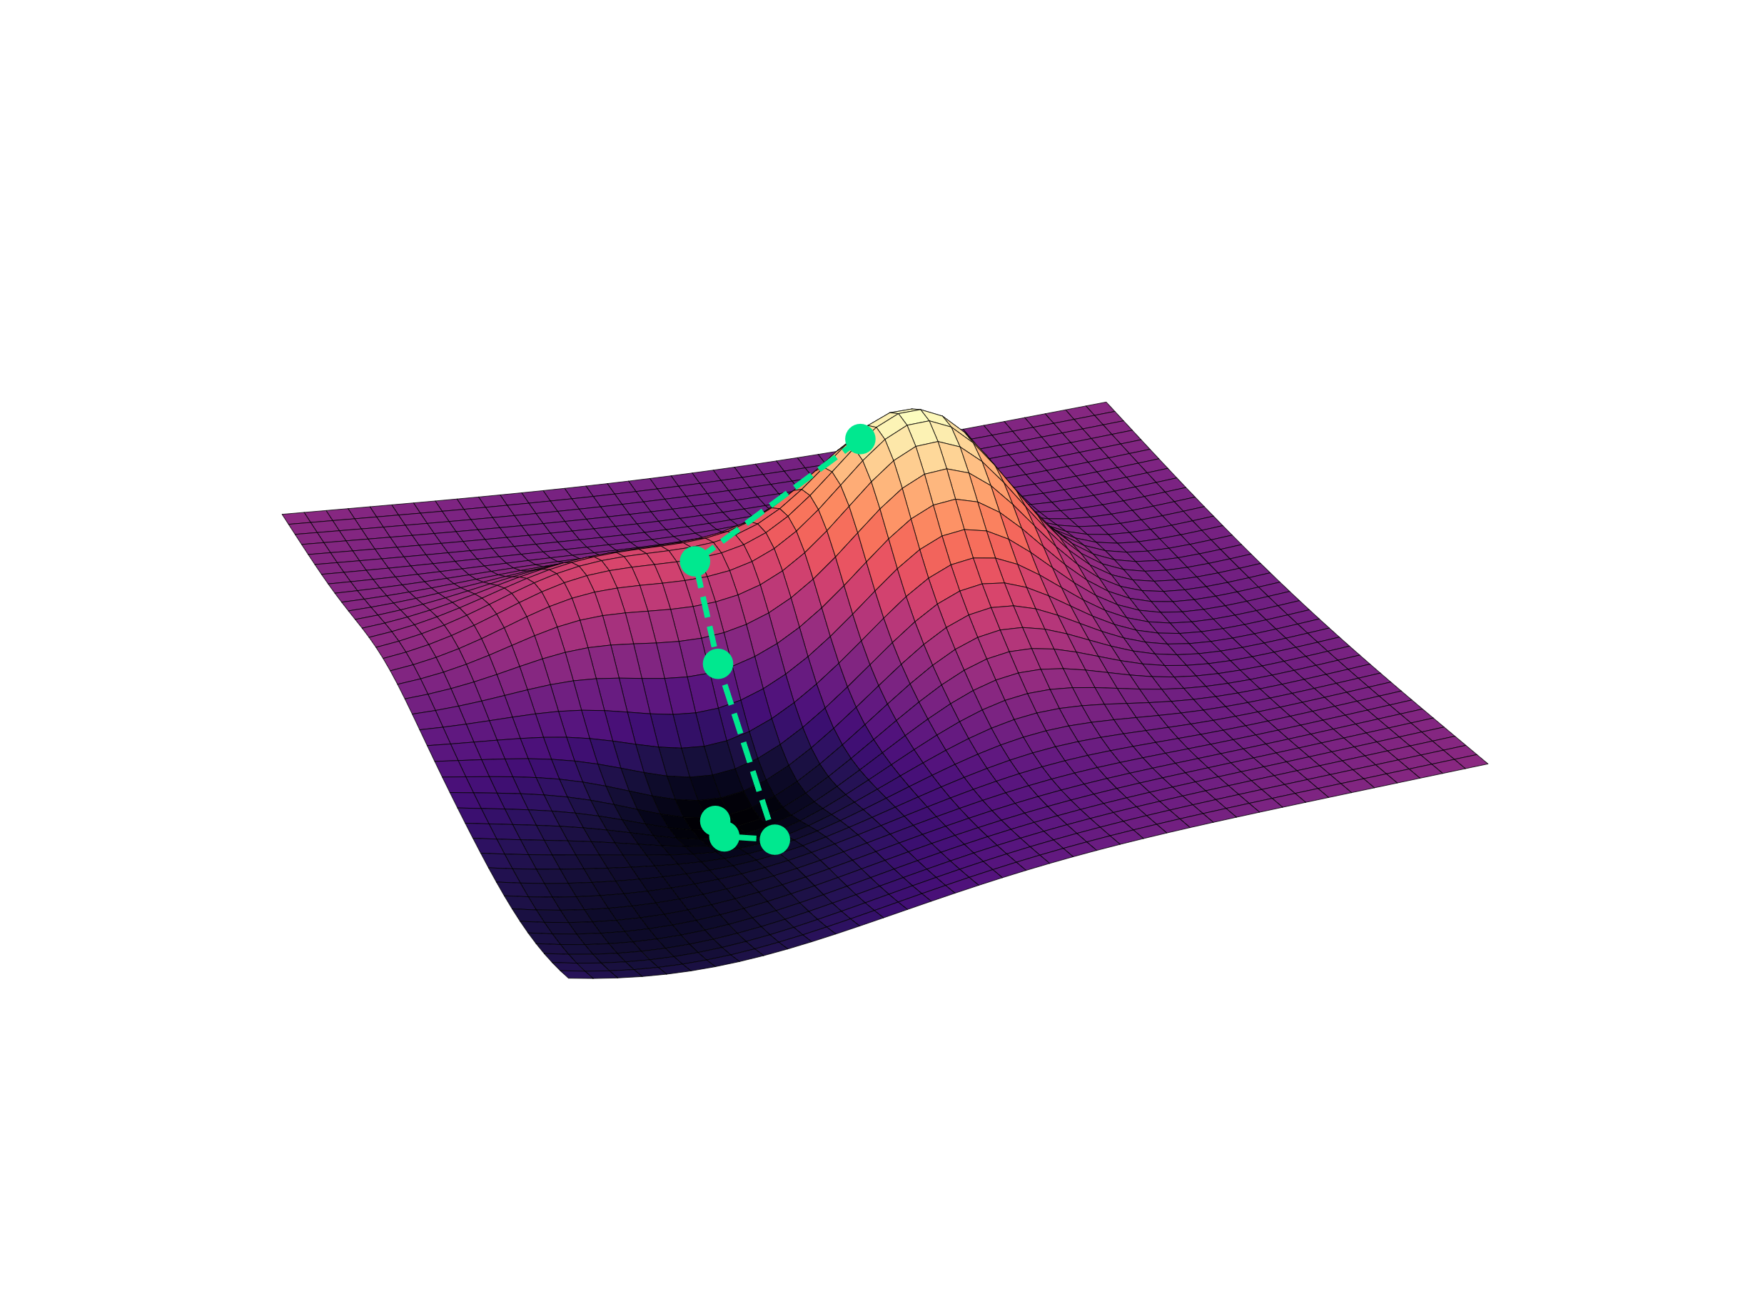

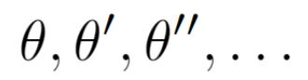
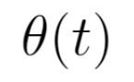
Neural Tangent Kernel
6
Notes:
Make clear that surface is the Loss function with previous slide. Sam und Konsti erwähnen „This is not the derivative“

Slide 23
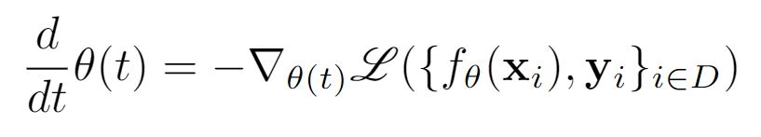
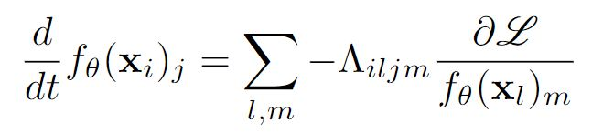
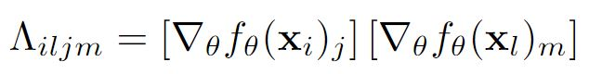
Neural Tangent Kernel
6
Notes:
Hier fehlt ein partial. Botschaft, NTK is essentiell für trainingsdynamik der outputs. Nicht zu oft „output dimension sagen“. Rote kästen. Bild von Neural Network

Slide 24
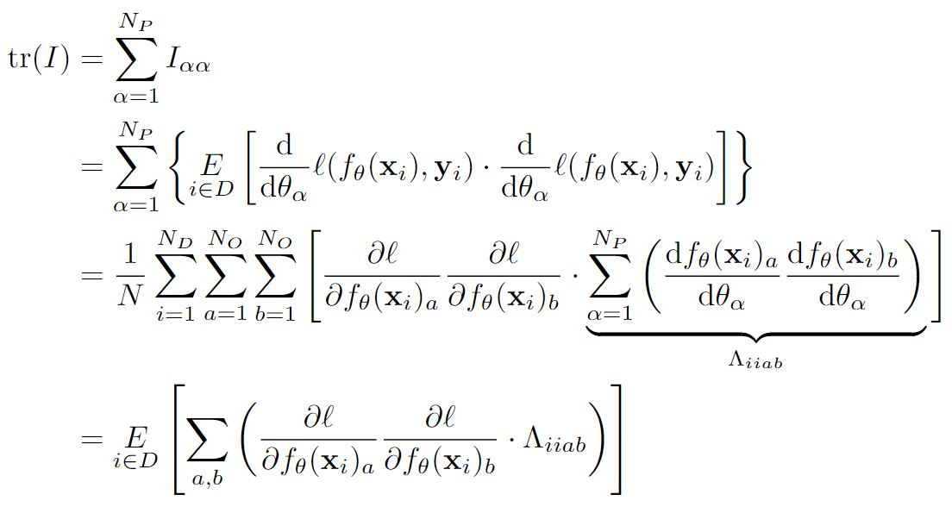
Relation between FI and NTK
7

Slide 25
Relation between FI and NTK
7

Slide 26
Relation between FI and NTK
7

Slide 27
Relation between FI and NTK
7

Slide 28
Relation between FI and NTK
7

Slide 29
Relation between FI and NTK
7

Slide 30
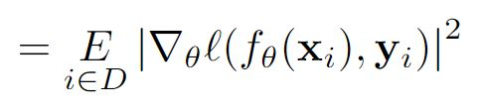
Relation between FI and NTK
7
Notes:
Ask sam what i should say about final message of slide. On point sein mit dem splitting der dynamik und dass ich das nachher untersuche.

Slide 31
Relation between FI and NTK
7

Slide 32
Relation between FI and NTK
7
Notes:
Loss dependend, Architecture Dependend schreiben?

Slide 33
Relation between FI and NTK
7

Slide 34
Relation between FI and NTK
7

Slide 35
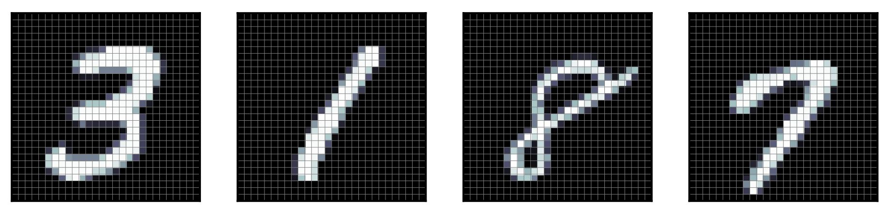
Experiments for Trace Comparison
MNIST Dataset:
8
Notes:
Klarer machen welche netzwerk/Loss-konfigurationen ich mir angucke

Slide 36
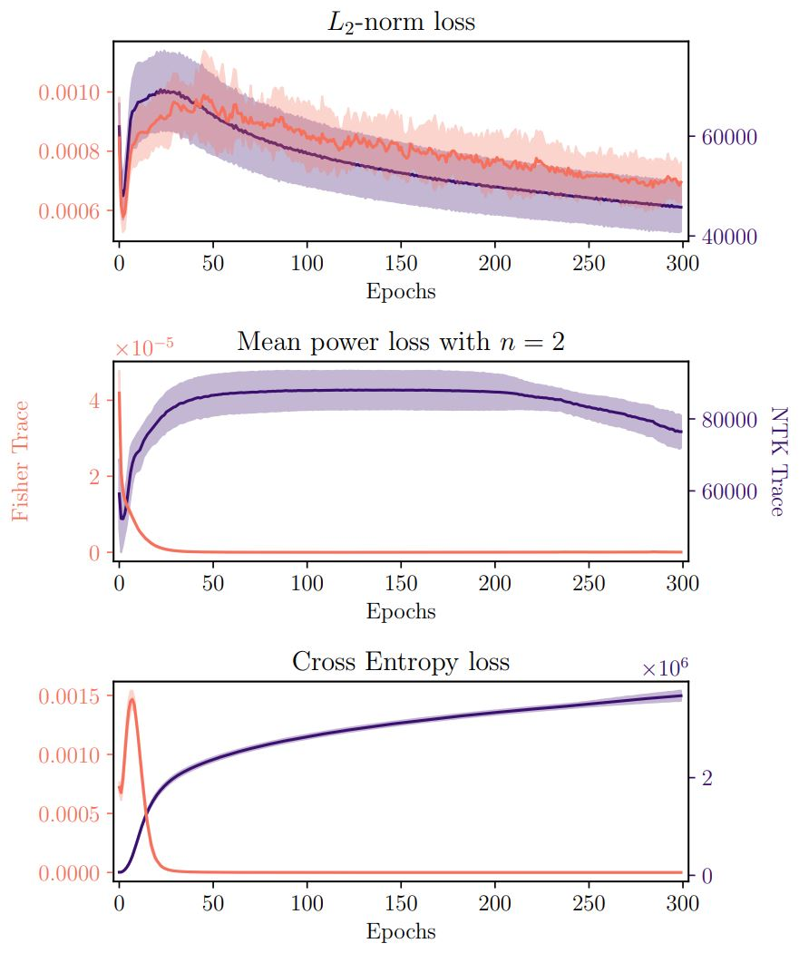
Experiments for Trace Comparison
8
Notes:
Abschließende worte, Sam fragen, labels erwähnen, „that you can see right there“. Curvature vorstellen als „das hat noch nich gereicht“, wir können noch mehr angucken.

Slide 37
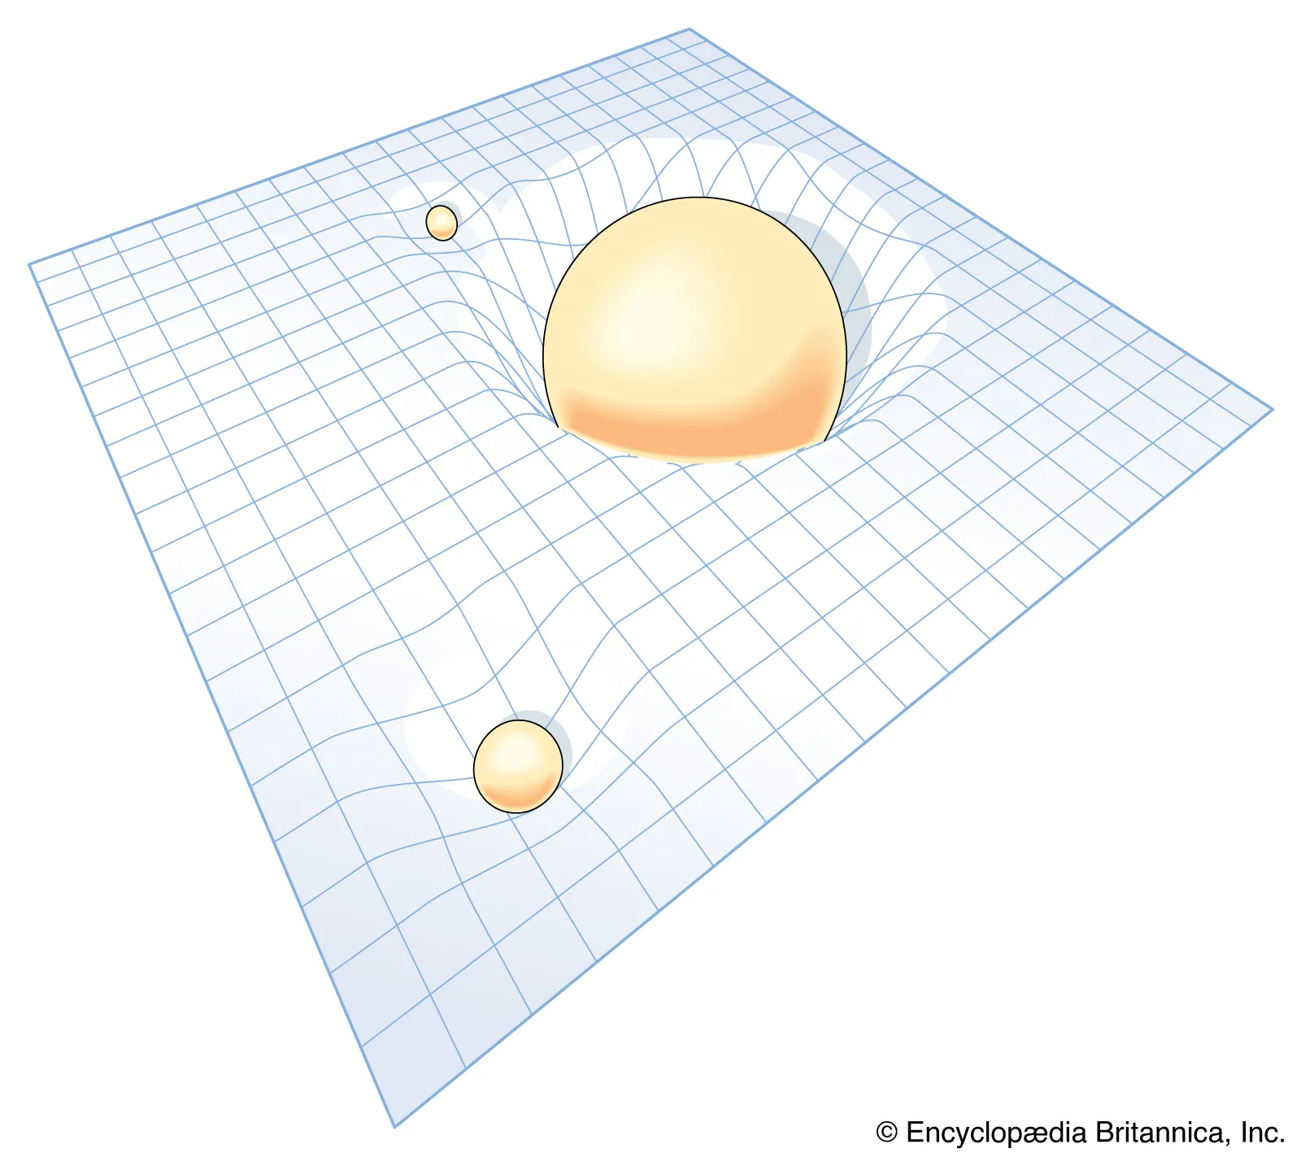
Curvature
https://www.britannica.com/science/relativity/Curved-space-time-and-geometric-gravitation
9
Notes:
What exactly was the motivation for doing so, whats the message, keep relativity short

Slide 38
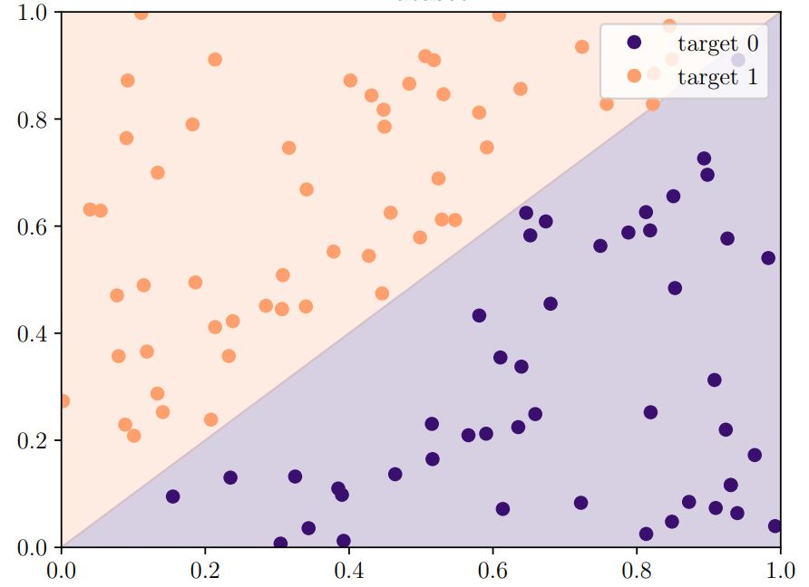
Curvature
9
Notes:
Erwähnen dass es mit zwei parametern laufen kann

Slide 39
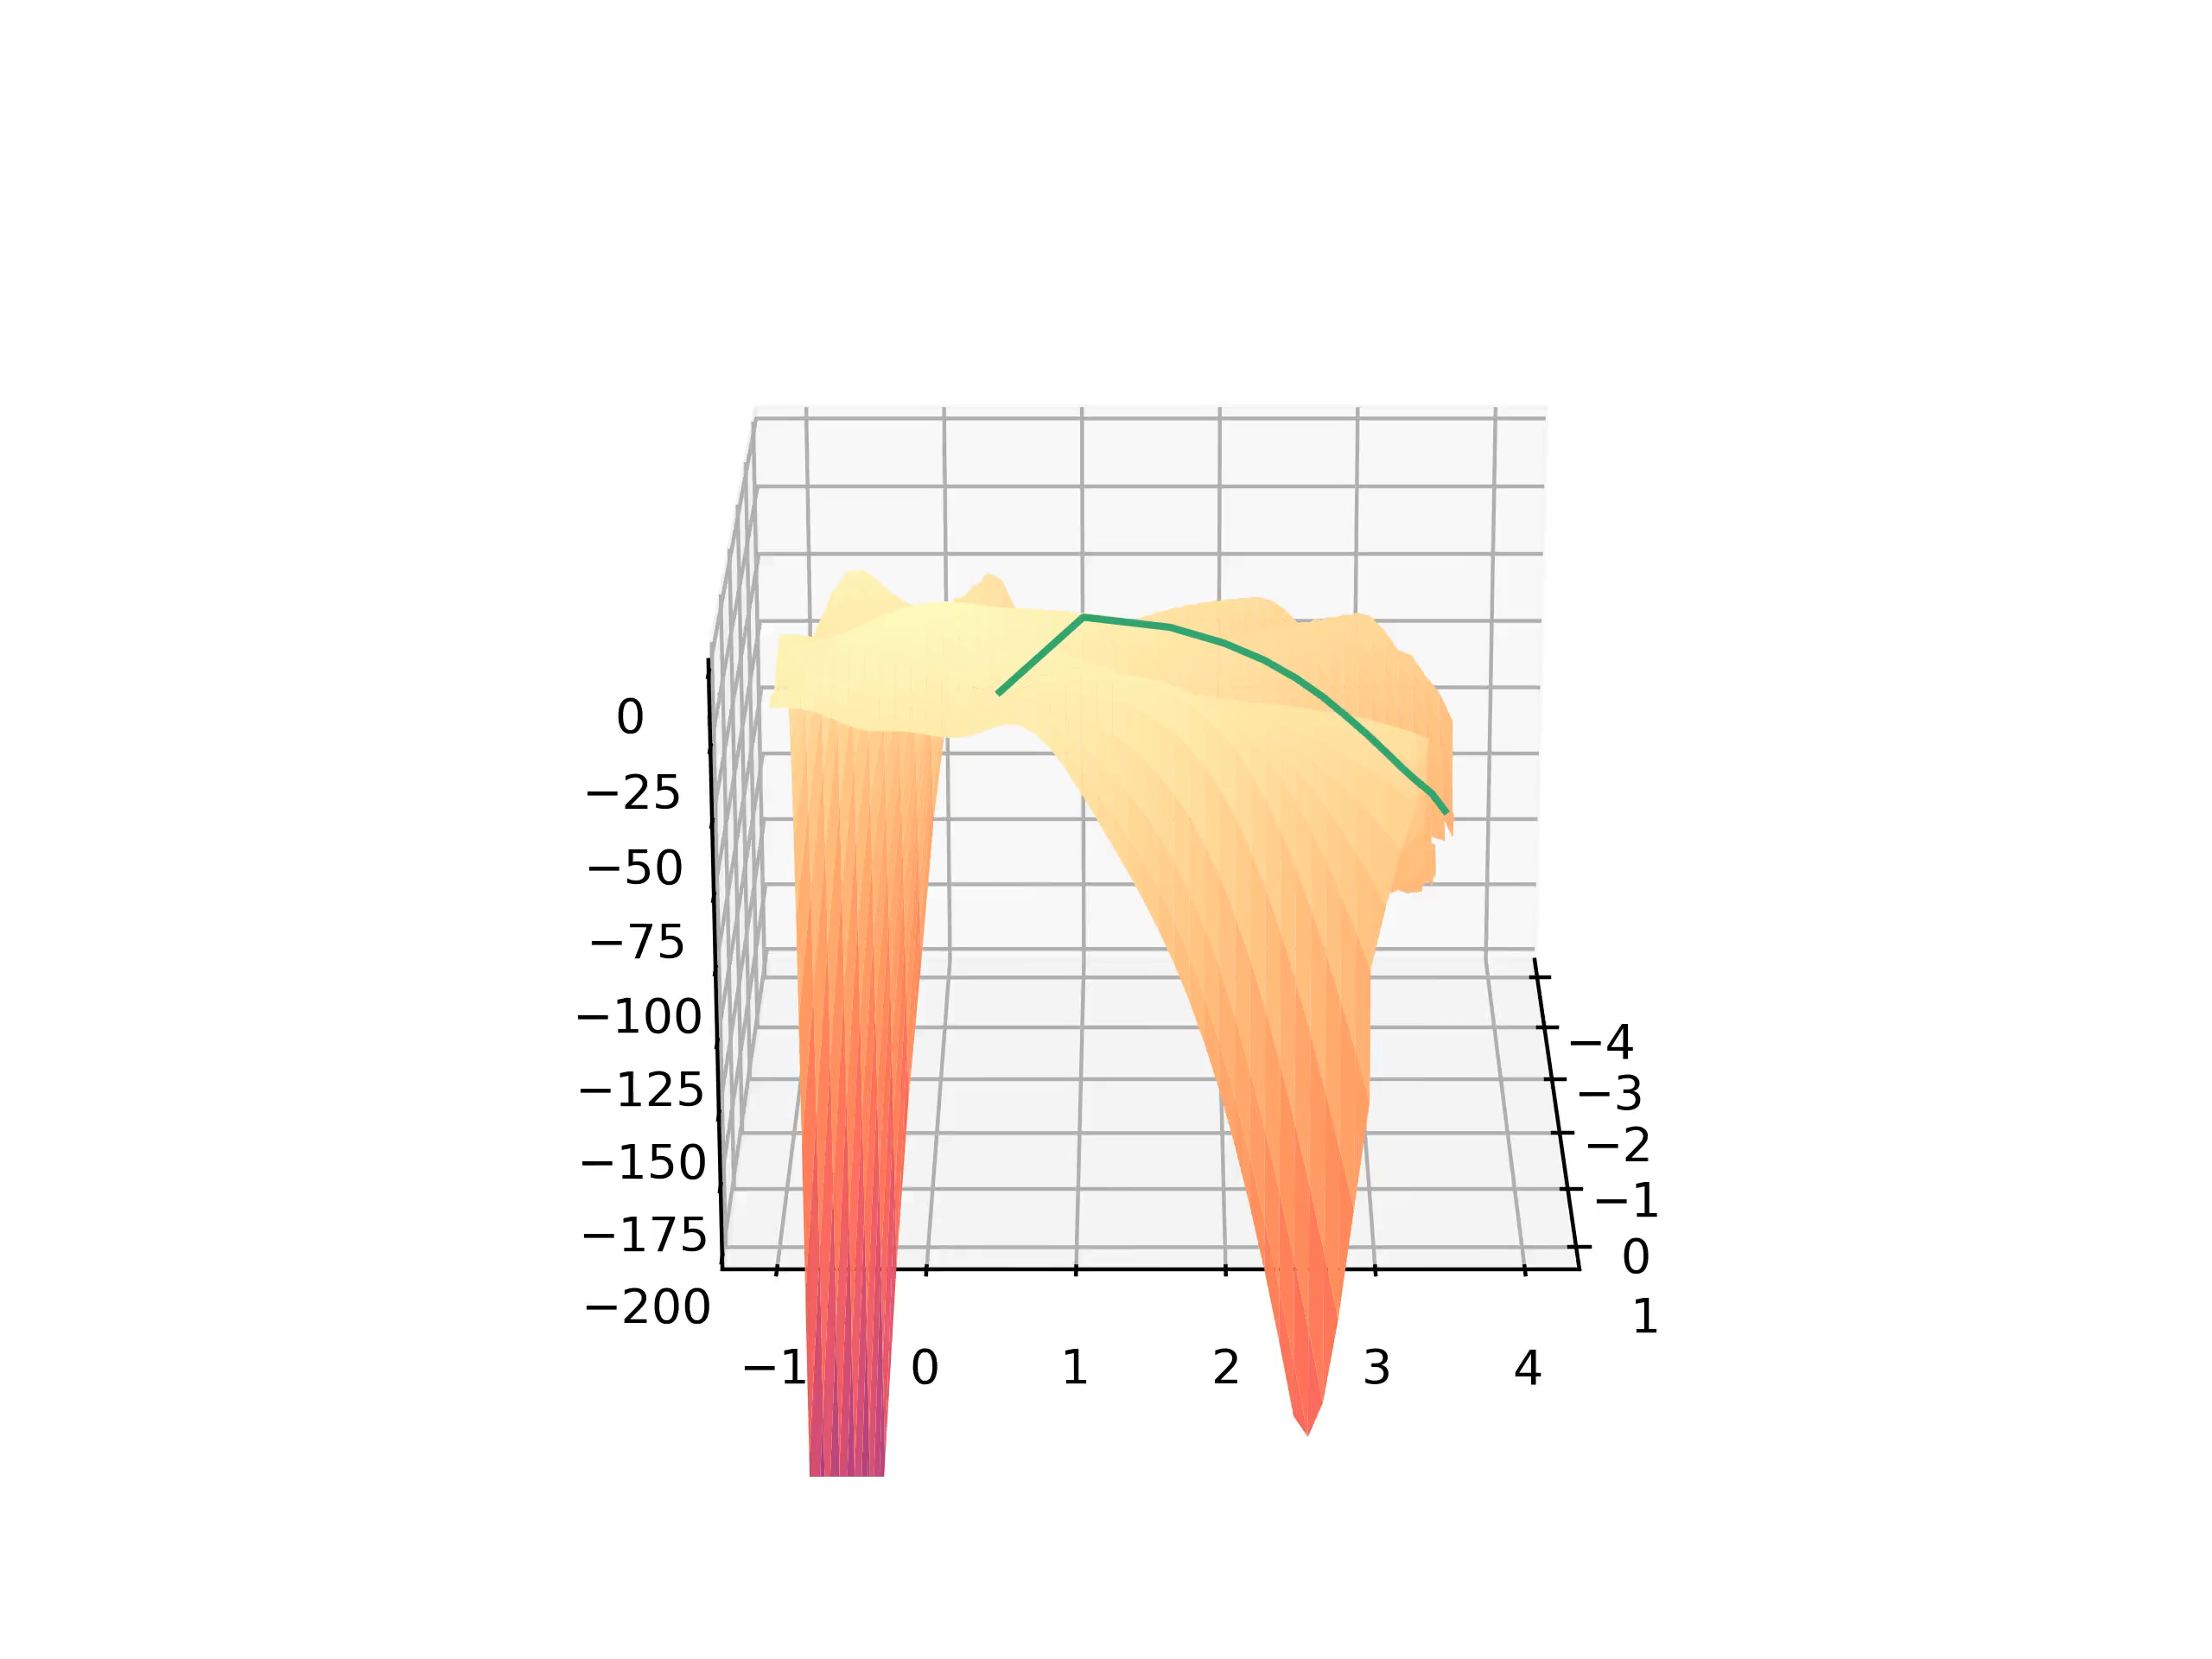
Curvature
Curvature for Lp-Norm Loss of order 2:
10
Notes:
Achsenbeschriftung

Slide 40
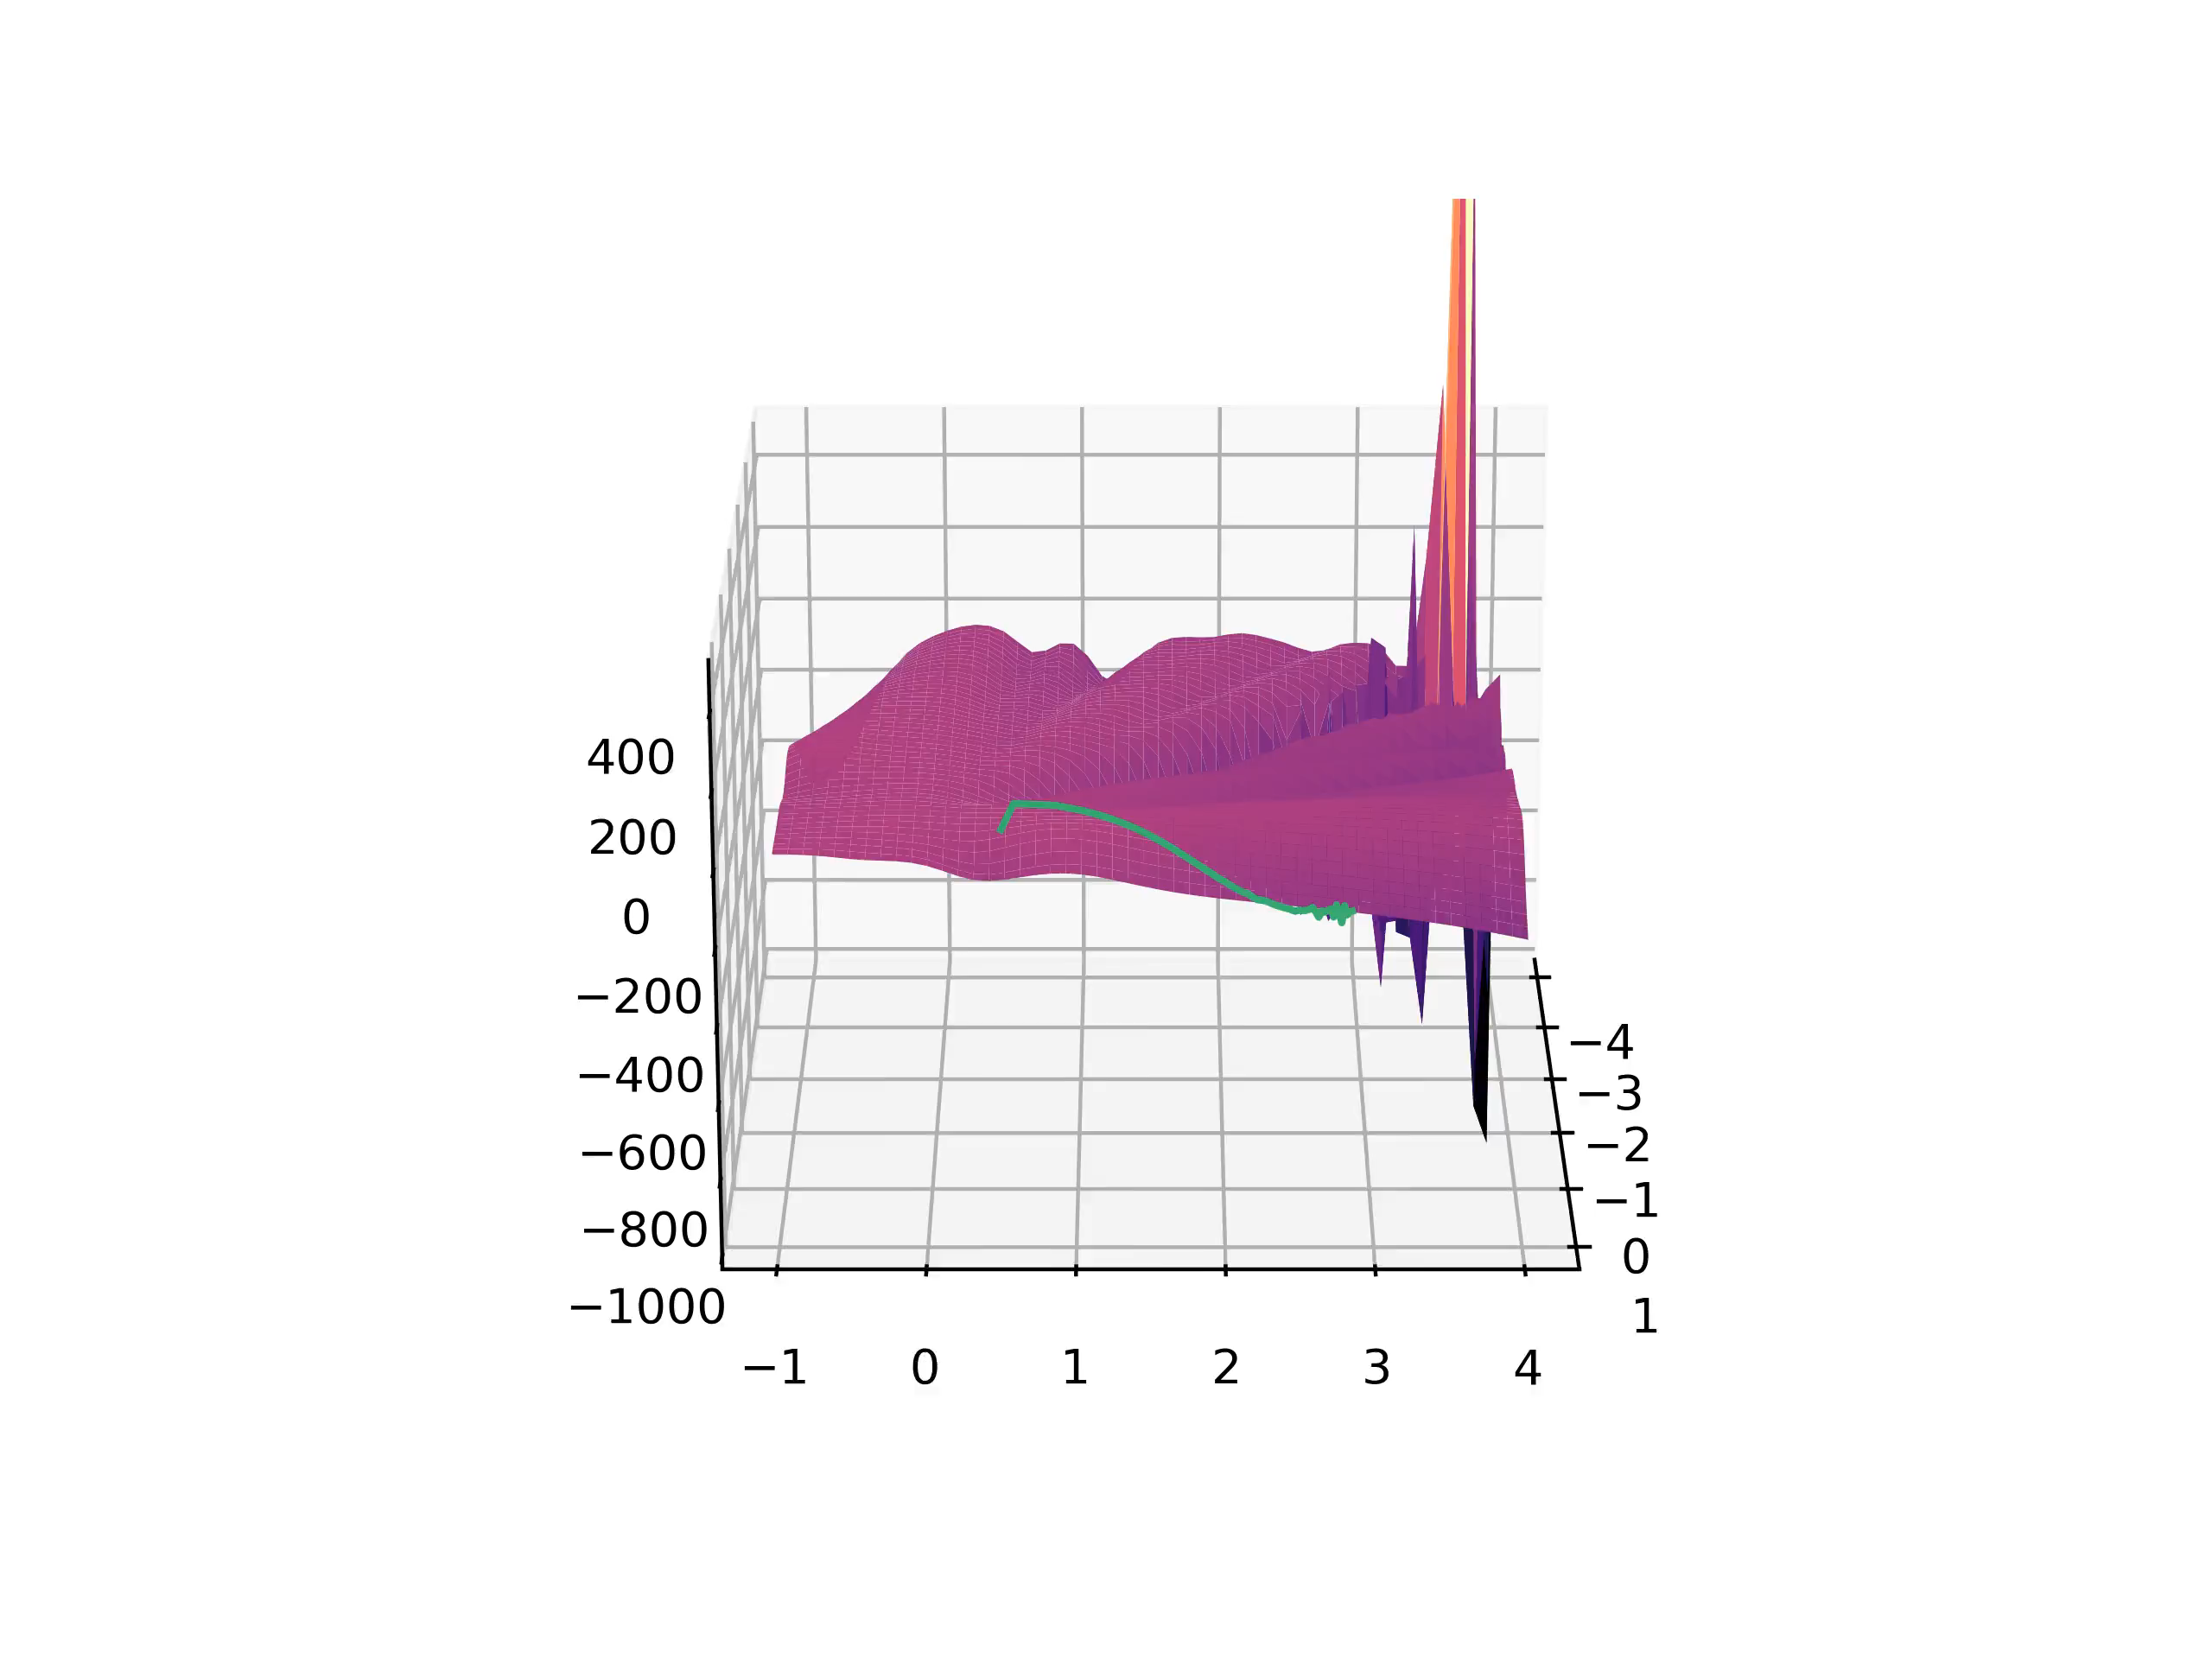
Curvature
Curvature for Mean-power Loss of order 2:
10

Slide 41
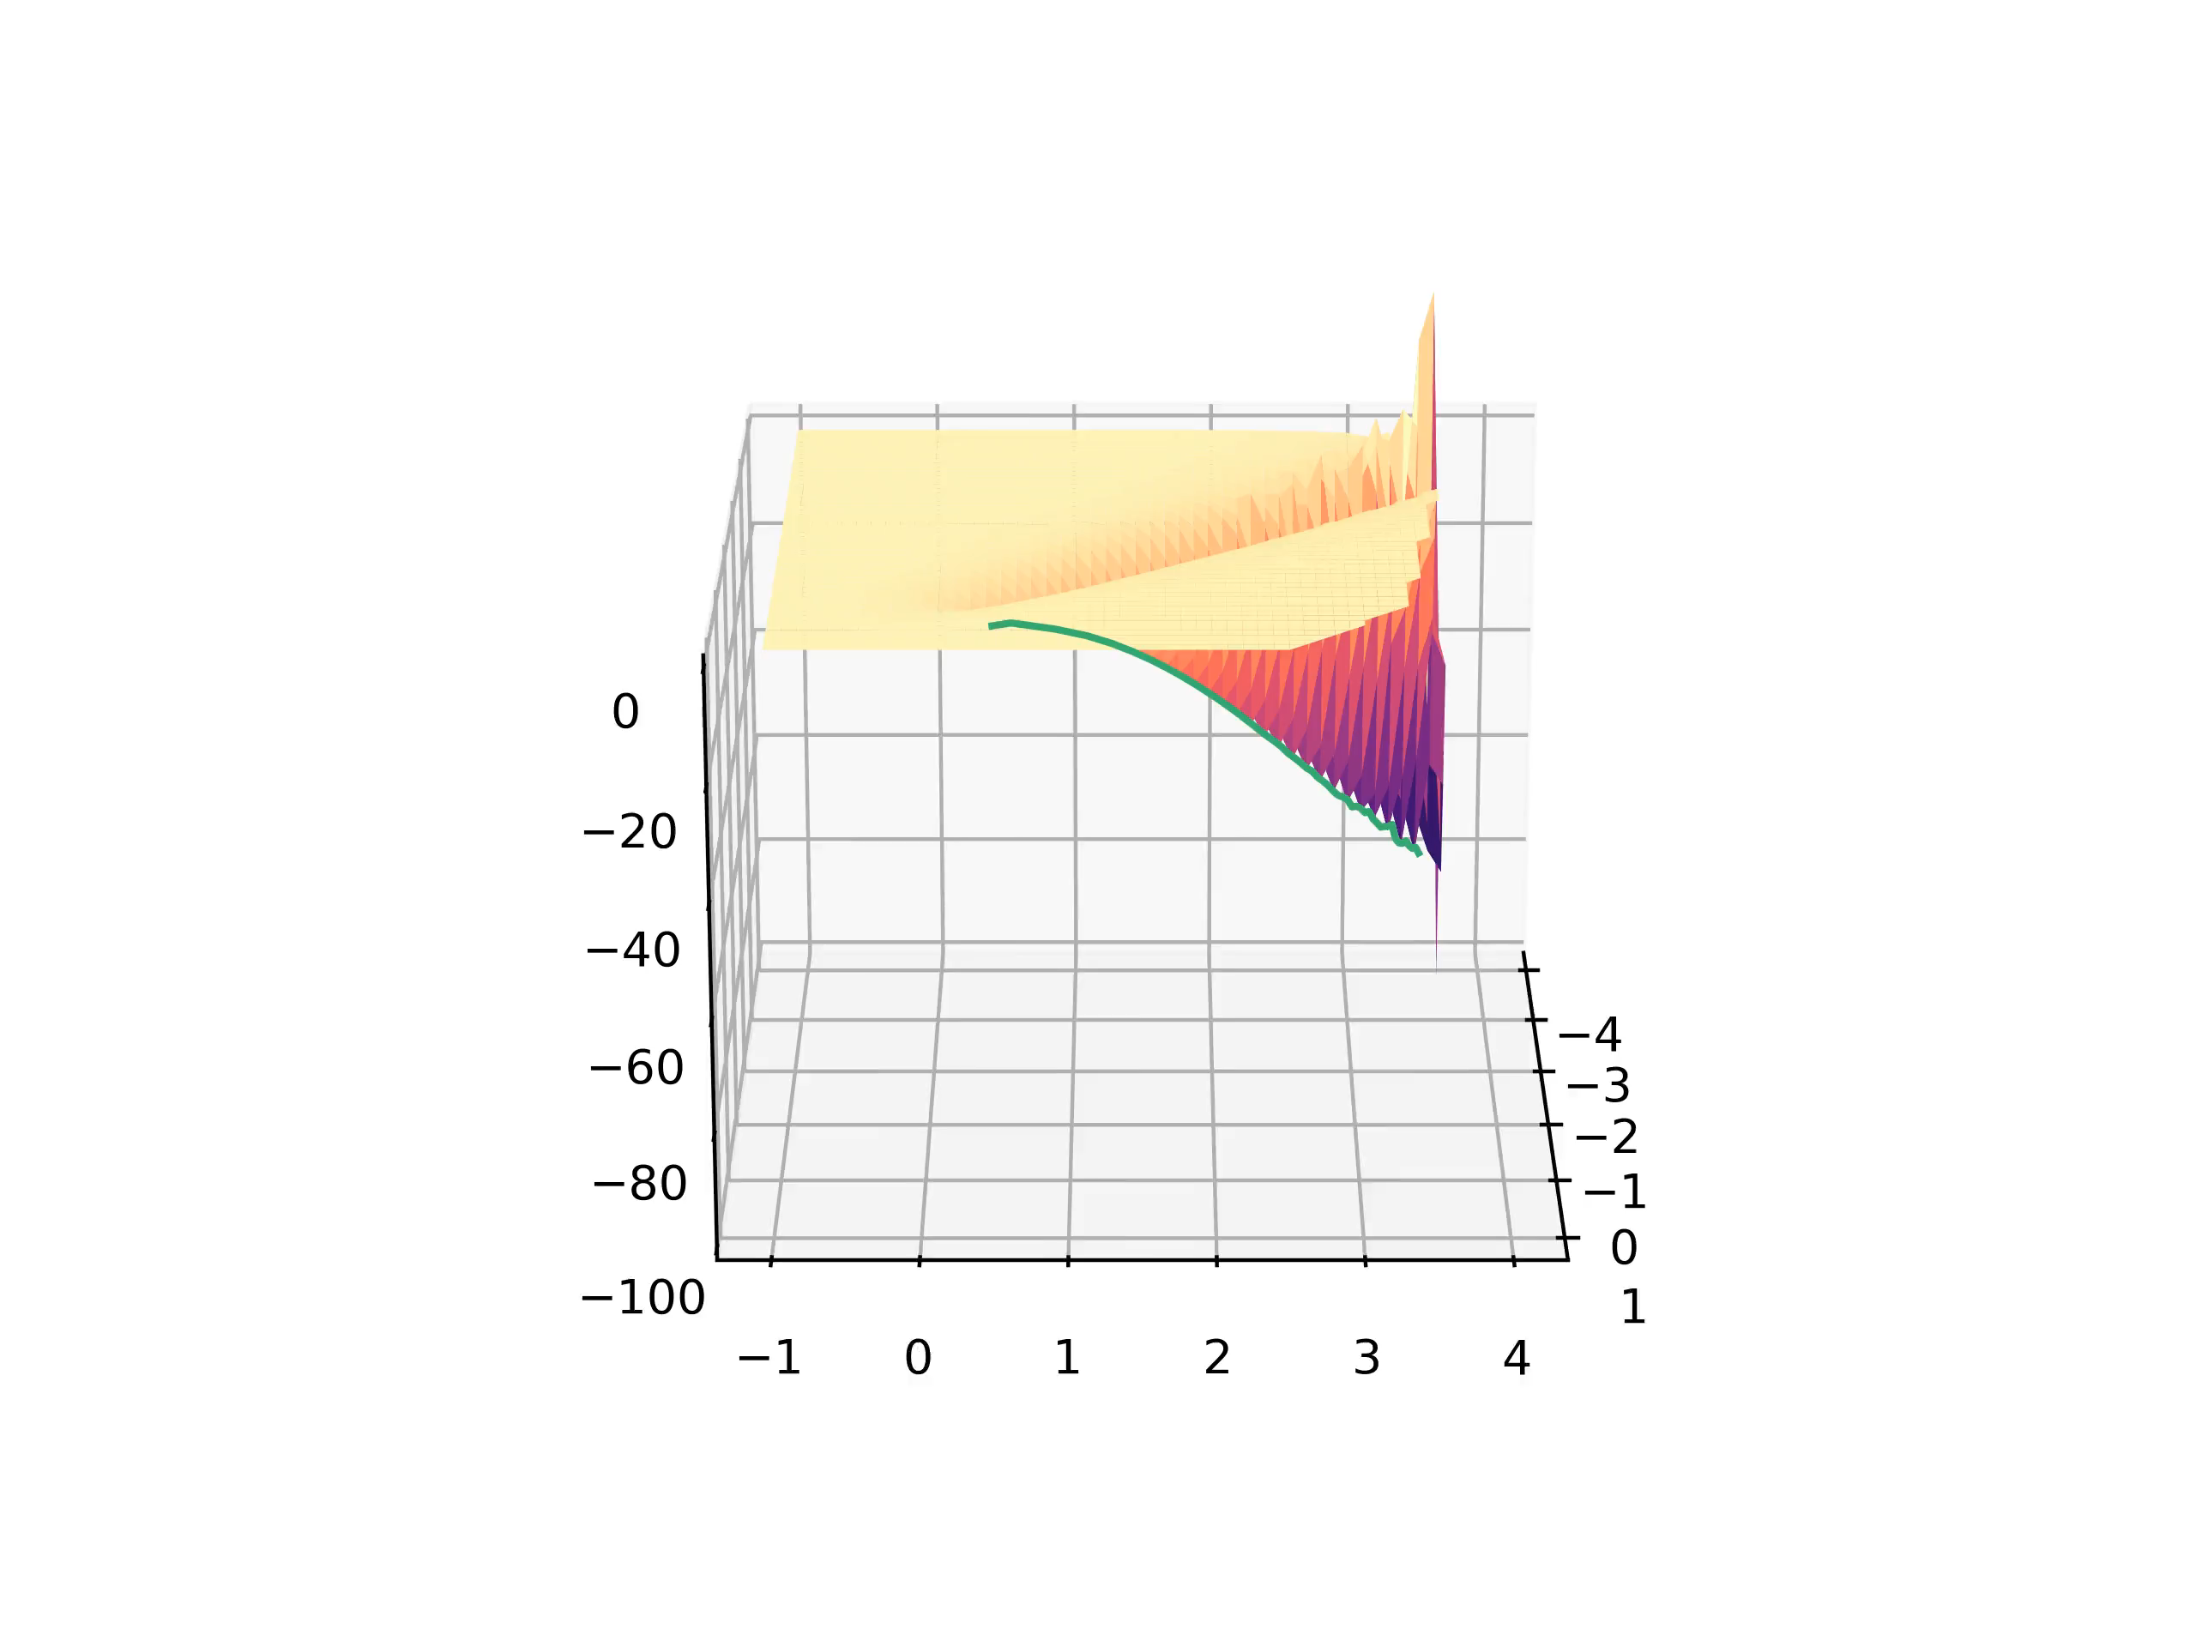
Curvature
Curvature for Cross-entropy Loss of order 2:
10

Slide 42
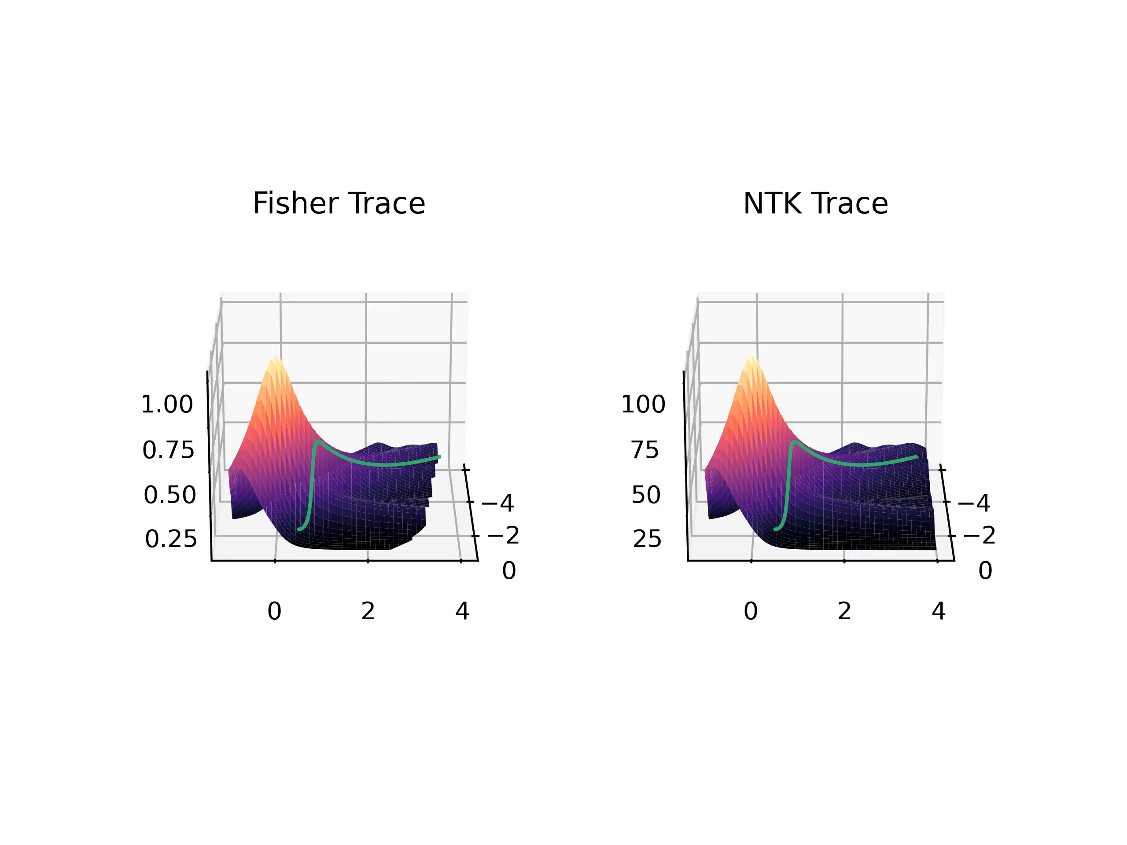
Further Results
Traces for Lp-Norm Loss of order 2:
11

Slide 43
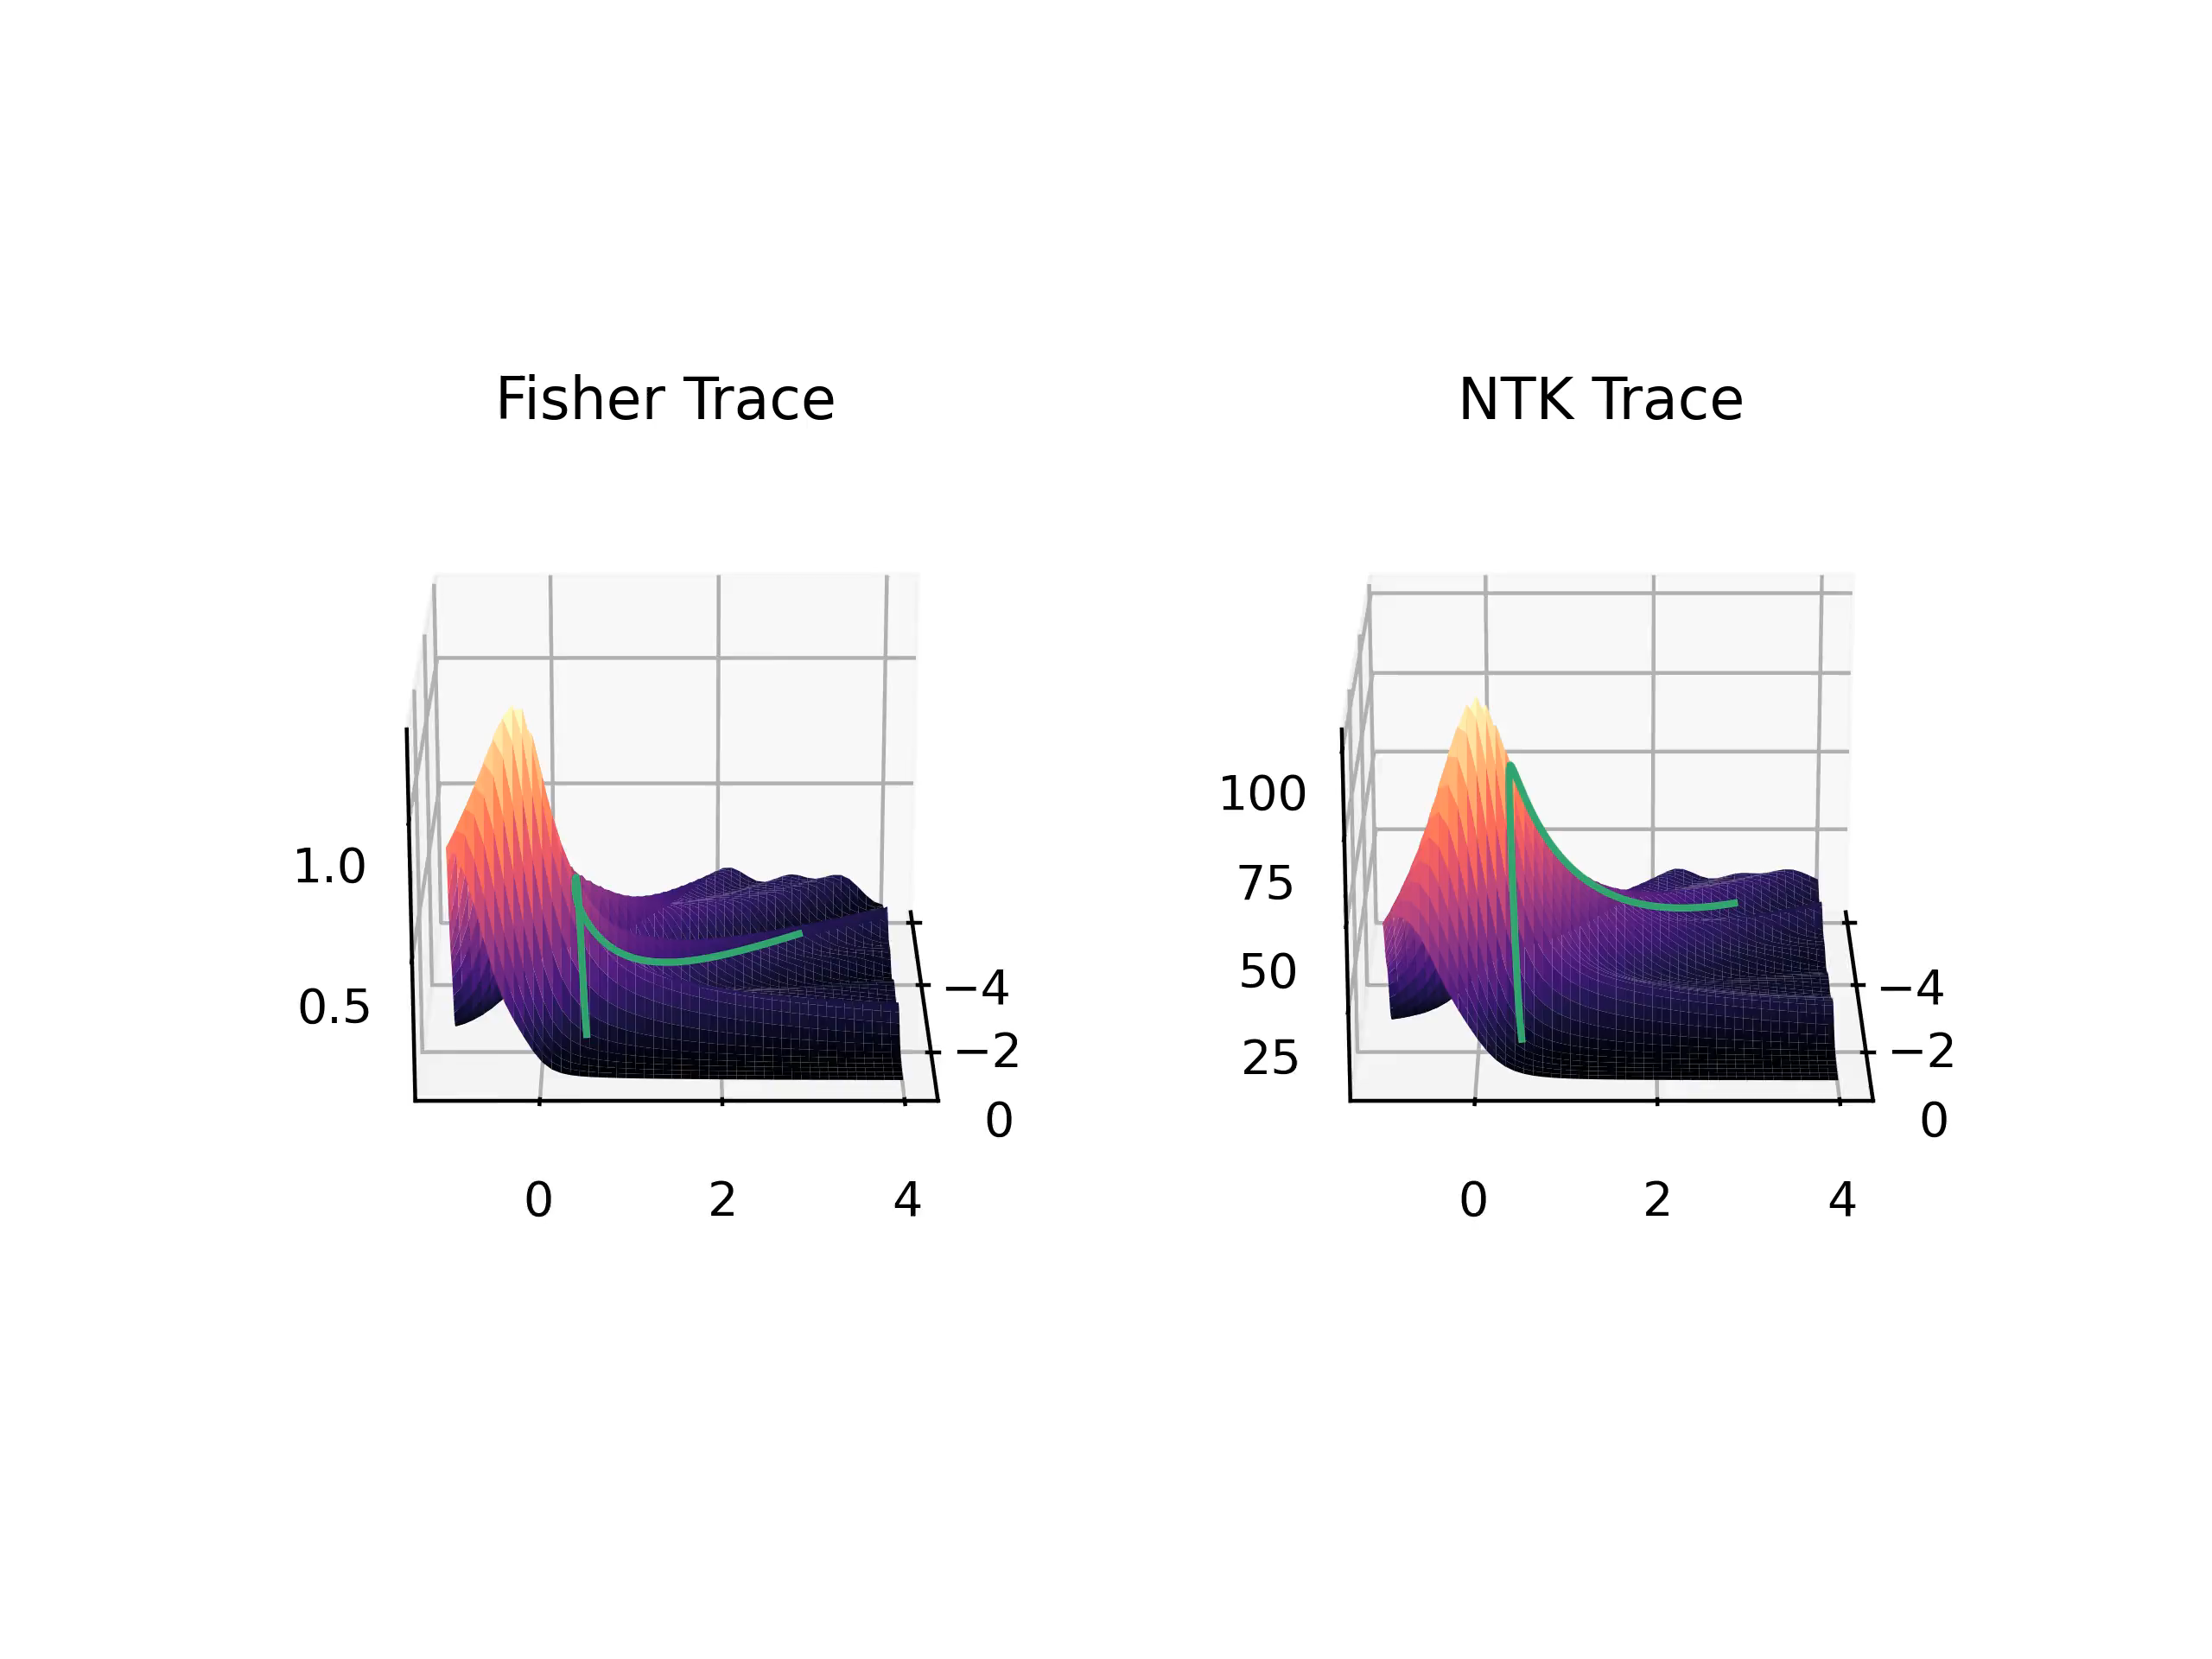
Further Results
Traces for Mean-power Loss of order 2:
11

Slide 44
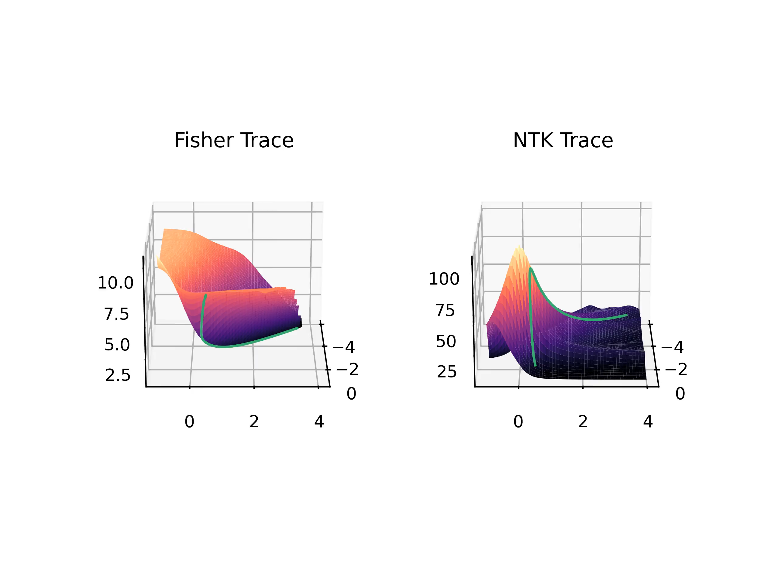
Further Results
Traces for Cross-entropy Loss:
11

Slide 45
Summary & Further Research
12

Slide 46
Summary & Further Research
What we looked at today:
How the Fisher Information describes the geometric properties of Neural Networks
How the NTK describes Neural Network behaviour in the output space
A relation between the trace of the Fisher Information and the NTK
Experiments investigating this relation
Further experiments that also include the scalar curvature calculated from the Fisher Information
12
Notes:
Rephrasing, make more clear what i did

Slide 47
Summary & Further Research
Further research possibilities:
Investigate further under which conditions the trace of the NTK is sufficient to determine the evolution of the trace of the Fisher information
Investigate what causes the different dynamics during training
Investigate if the curvature of the Network can yield information about training dynamics
Further Investigations using the trace of the Fisher Information
12
Notes:
Bilder, questions, Nicht wirken lassen als hätte ich das gefühl das war wenig -> kürzer und prägnanter drüber reden

Slide 48
Questions
?

Slide 49
Backup Slides

Slide 50
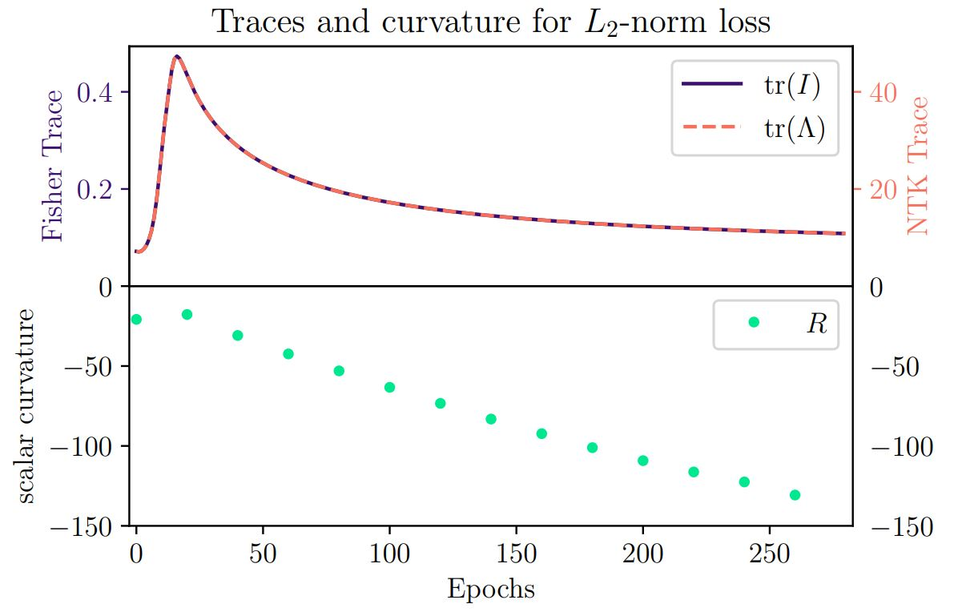
Comparison of traces and Curvature

Slide 51
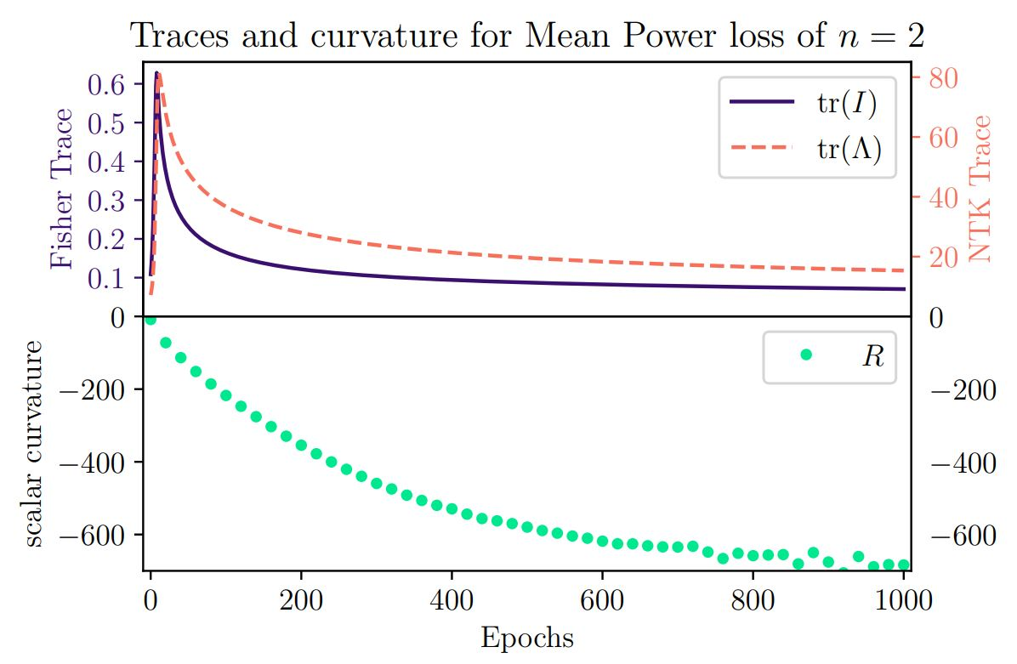
Comparison of traces and Curvature

Slide 52
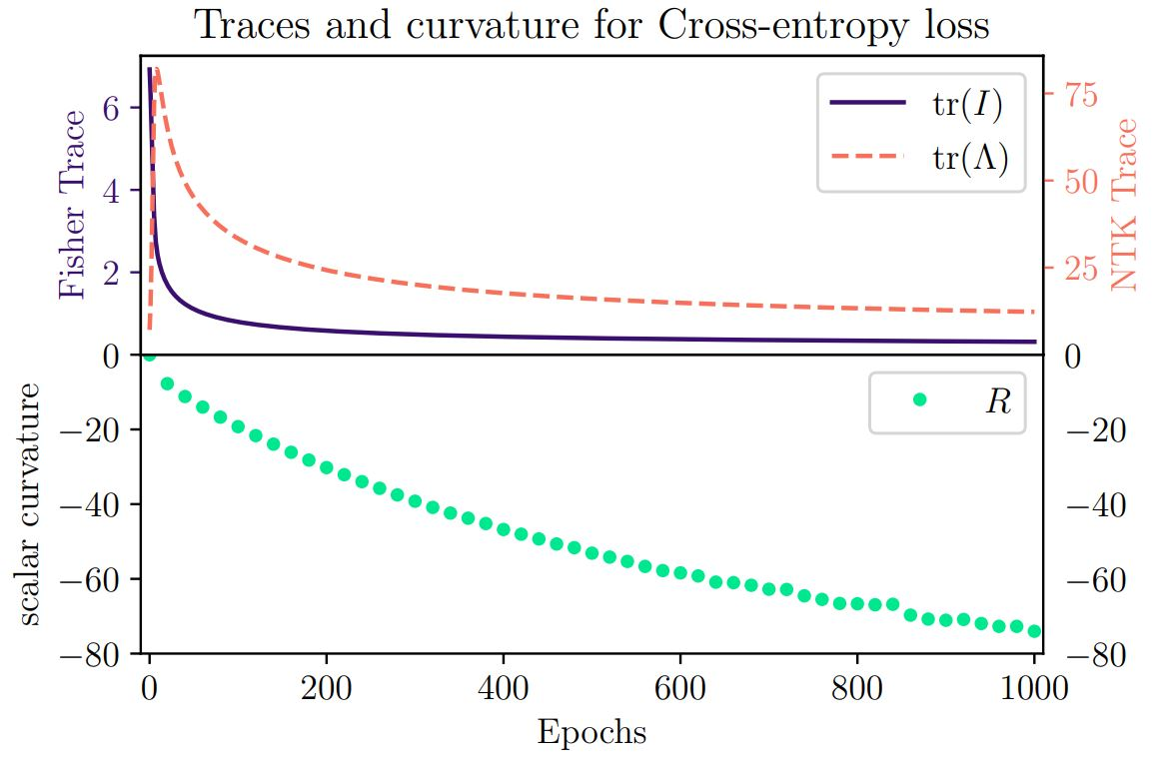
Comparison of traces and Curvature

